Slide 1
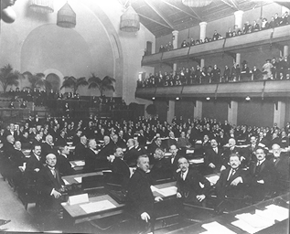
2. To what extent was the League of Nations a success?

Slide 2
Background
During the First world war a number of statesmen began discussing ways to avoid another international conflict.
These statesmen included Jan Smuts of South Africa, Lloyd George of Britain, and Woodrow Wilson of the United States.
A variety of possible schemes were considered.
These included:
A narrowly-focused organization that would meet to sort out disputes and crises.
An organization backed by an army that would exist to enforce the peace settlement.
A broad-based organization that would address a wide range of international problems as well as meet to sort out disputes and crises.

Slide 3
Background
It was envisioned to be a truly INTERNATIONAL organization which would MAINTAIN WORLD PEACE AND SECURITY by ACTING TOGETHER to PREVENT WAR
Collective Security

Slide 4
An Artist’s impression on the League of Nation. What is the artist trying to say about the LON?

Slide 5
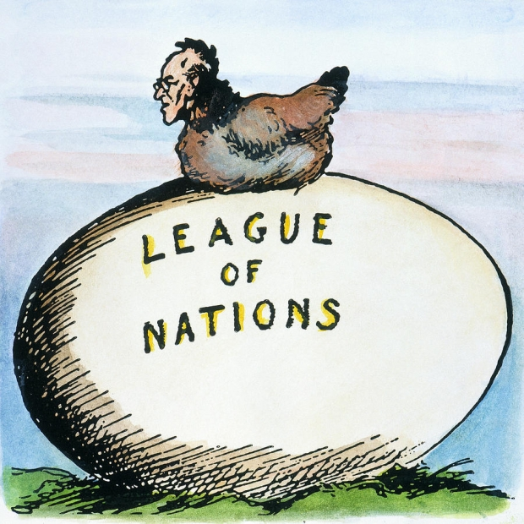
Reasons for The League of Nations
The League of Nations (LON) is an intergovernmental organization established on the 10th of January 1920
It was the predecessor of the United Nations and has its offices in Geneva, Switzerland.
The LON operates on a covenant centered around Wilson’s 14points
The idea of a League of Nations was not new, but struck a cord with the peoples of Europe after the devastation of World War 1

Slide 6
Aims of the League of Nations
(KEEPP)
Keep world peace by discouraging aggression from any nation.
Encourage co-operation between countries to boost trade and commerce
Enhance living and working conditions
Persuade nations to disarm
Peace Treaty of Versailles, to uphold its terms
Consider the aims of the league of nations, Were they realistic in light of the recent war?

Slide 7
Aims of the League
Important Note:
When EVALUATING HOW SUCCESSFUL / HOW MUCH A FAILURE the League of Nations was … you must look at HOW MUCH of its AIMS the League was able to FULFIL:
To promote international co-operation, peace and security by accepting an obligation not to go to war
To promote open, just and honorable relations between nations
To lay out a system of international law
To maintain, or help to modify, treaties between nations

Slide 8
Structure of the LON
1) The Council (consisted of 4 permanent members)
2) The Assembly (consisted of all the other members)
3) The Secretariat (consisted of a Secretary General and is responsible for the day-to-day running of the LON)
COUNCIL
S
E
C
R
E
T
A
R
I
A
T
ASSEMBLY

Slide 9
Structure of the LON
The council is made of the four strongest members of the LON they are the victors of World War 1
The council met 4-5 times a year or periodically to settle international disputes. A total of 107 public sessions from 1920-1939.
Decisions had to be unanimous
Implications?
COUNCIL

Slide 10
Structure of the LON
The Assembly consisted of all the other member nations of the LON.
The Assembly met once a year to debate on international affairs. Smaller nations had a forum for which to voice their opinions.
Decisions had to be unanimous
ASSEMBLY

Slide 11
… decisions had to be UNANIMOUS

Slide 12
Unanimous decisions
Why were unanimous decisions required in the Assembly and Council?
Unanimous decisions appear obvious obstructions to the work of the League but the unanimous decision requirement was quite deliberate.
The intention was to prevent the League from being dominated by the most important countries with major world influence.
By requiring unanimous decisions, all countries had an equal say in the League. This meant that a country like Belgium had to be treated with the sam respect as a country like France.

Slide 13
How was the League organized?
Lets look at page 24 in your book to see the organization.

Slide 14
How far did weakness in the League’s organization make failure inevitable?

Slide 15
Membership of the League of Nations
During the establishment of the LON the League had 42 members. At its peak the League had 60 members. However, the League was not a firm unit as the league suffered frequent membership changes.
Why?

Slide 16
Membership of the League of Nations
Important: Although the LON operated along the 14 points and the ideas of President Woodrow Wilson. USA was never a part of the LON!

Slide 17
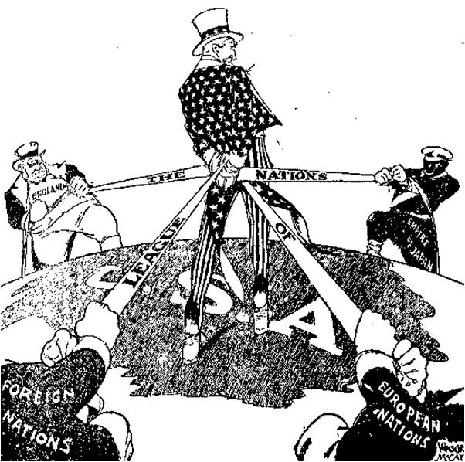

Slide 18
The League of Nation was like…

Slide 19
But…
How strong was the League without the most powerful nations?

Slide 20
Membership of the League of Nations
Germany, Russia and China were disallowed membership. Germany was only given membership when they showed willingness to abide by the treaty.
The membership of the LON was always changing. (WHY?)
1945
France 1919
1945
Britain 1919
Italy 1919
1937
Japan 1919
1933
Germany 1926
1933
USSR 1934
1939

Slide 21
Membership
USA was not a member
Germany, Austria and Hungary were not allowed to join (resented by Germany)
Constant shift of membership as joining and leaving the League was very easy
Many countries left because the League opposed their actions (Italy and Japan) or because it wasn't doing much to help.
The League had very little control over its member states

Slide 22
Weakness of the League of Nations
Weakest at dealing with issues that nations saw as a threat to their security
Most members of the League were unwilling to put the security of their nations at risk in order to fulfill collective security
Attitudes to the League
Mandates
Difficulties in Resolving Disputes

Slide 23
Weakness of the League of Nations
Mandates
The legal right to govern under the control of the League
Took over most of Germany’s former colonies
Countries holding colonies in mandate had to help the colonies move to self-government as soon as possible
However, even after 20 years, this was not happening and many countries who had been in favour of the League turned against it

Slide 24
Weakness of the League of Nations
Difficulties in Resolving Disputes
Usual form of punishment for disobeying the League was the imposing of SANCTIONS (not allowing trade to take place)
Method was quite useless because sanctions hurt trade with other countries so they were removed as quickly as they were imposed
League had no force of its own (expected members to contribute troops) so it could not prevent the rise of authoritarian regimes in Germany, Italy and Japan

Slide 25
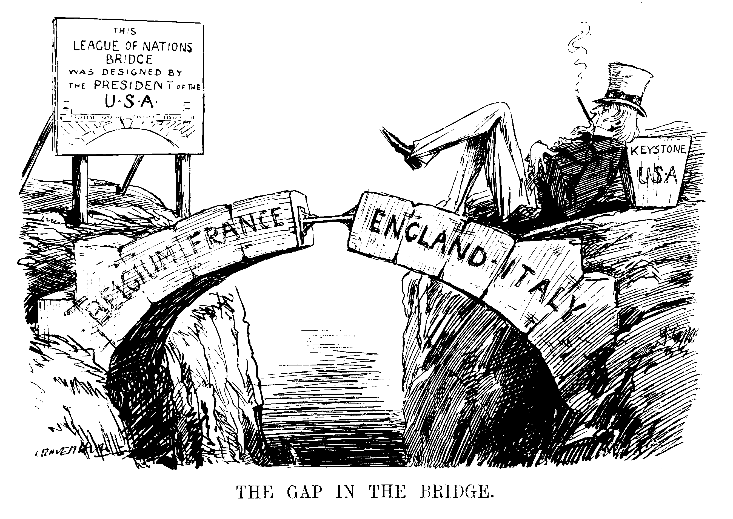

Slide 26
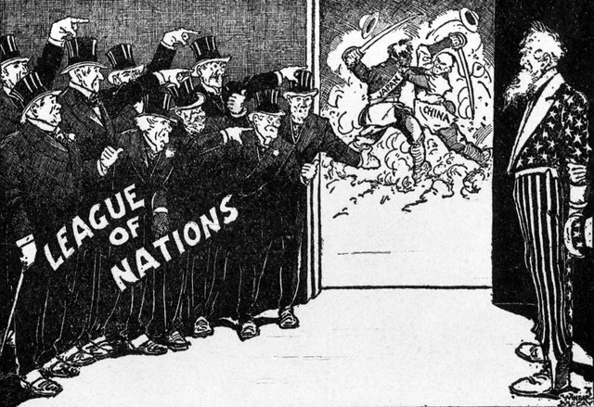

Slide 27
Collective Security
The League’s Powers. (When a nation acted illegally the league could..)
Condemn
Tell a country that it has done wrong in the open Assembly.
Arbitration
Offer to mediate between the two conflicting countries.
Sanctions
Impose a trade embargo to push the country towards bankruptcy .

Slide 28
Collective Security
When a nation needs help the LON could:
Organize Aid
Send supplies and expertise to ailing countries. Send volunteer forces.
Give Smaller nations a voice
The Assembly is used as a forum for small nations to have speak their views.

Slide 29
Collective Security
Moral Disapproval | Following an act of aggression the Council would meet and vote to condemn the action
 | The aggressive country, knowing that it had the weight of the world opinion directed against it, might drop its aggressive action.
Economic Sanctions | If moral disapproval failed then the council could impose economic sanctions on the aggressor.
 | This meant arranging a trade boycott and refusing credit.
Military Sanctions | If economic sanctions failed then as a last resort, the Council could impose military sanctions.
 | This might involve sending an army to assist the victim of the aggression.

Slide 30
The League’s Powers
The league however had no real army to enforce their rules.
LON FIGHTING STRONG
Since 1920

Slide 31
Objectives for today: Successes & Failures of the League of Nations
What criteria should we use to judge the LON’s successes/failures?
We judge the LON base on its stated aims KEEPP

Slide 32
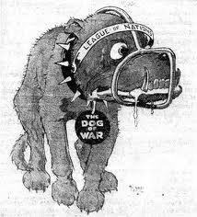
Successes of the League of Nations
Politically, in its early years the LON appeared to have made progress towards preventing war.
1)(1921) The Aaland Islands
2)(1921) Upper Silesia
3) (1924) Mosul
4)(1925) Greece and Bulgaria
Persuade nations to disarm
Peace Treaty of Versailles, to uphold its terms (?)

Slide 33
Aaland Islands, 1921
The first dispute to be satisfactorily resolved by the League concerned the rival claims of Sweden and Finland to the Aaland Islands situated in the Baltic Sea.
Most of the islanders wanted to be ruled by Sweden.
The League investigated the matter and awarded the islands to Finland but with safeguards for the islanders including demilitarization.
Sweden accepted the judgment.

Slide 34
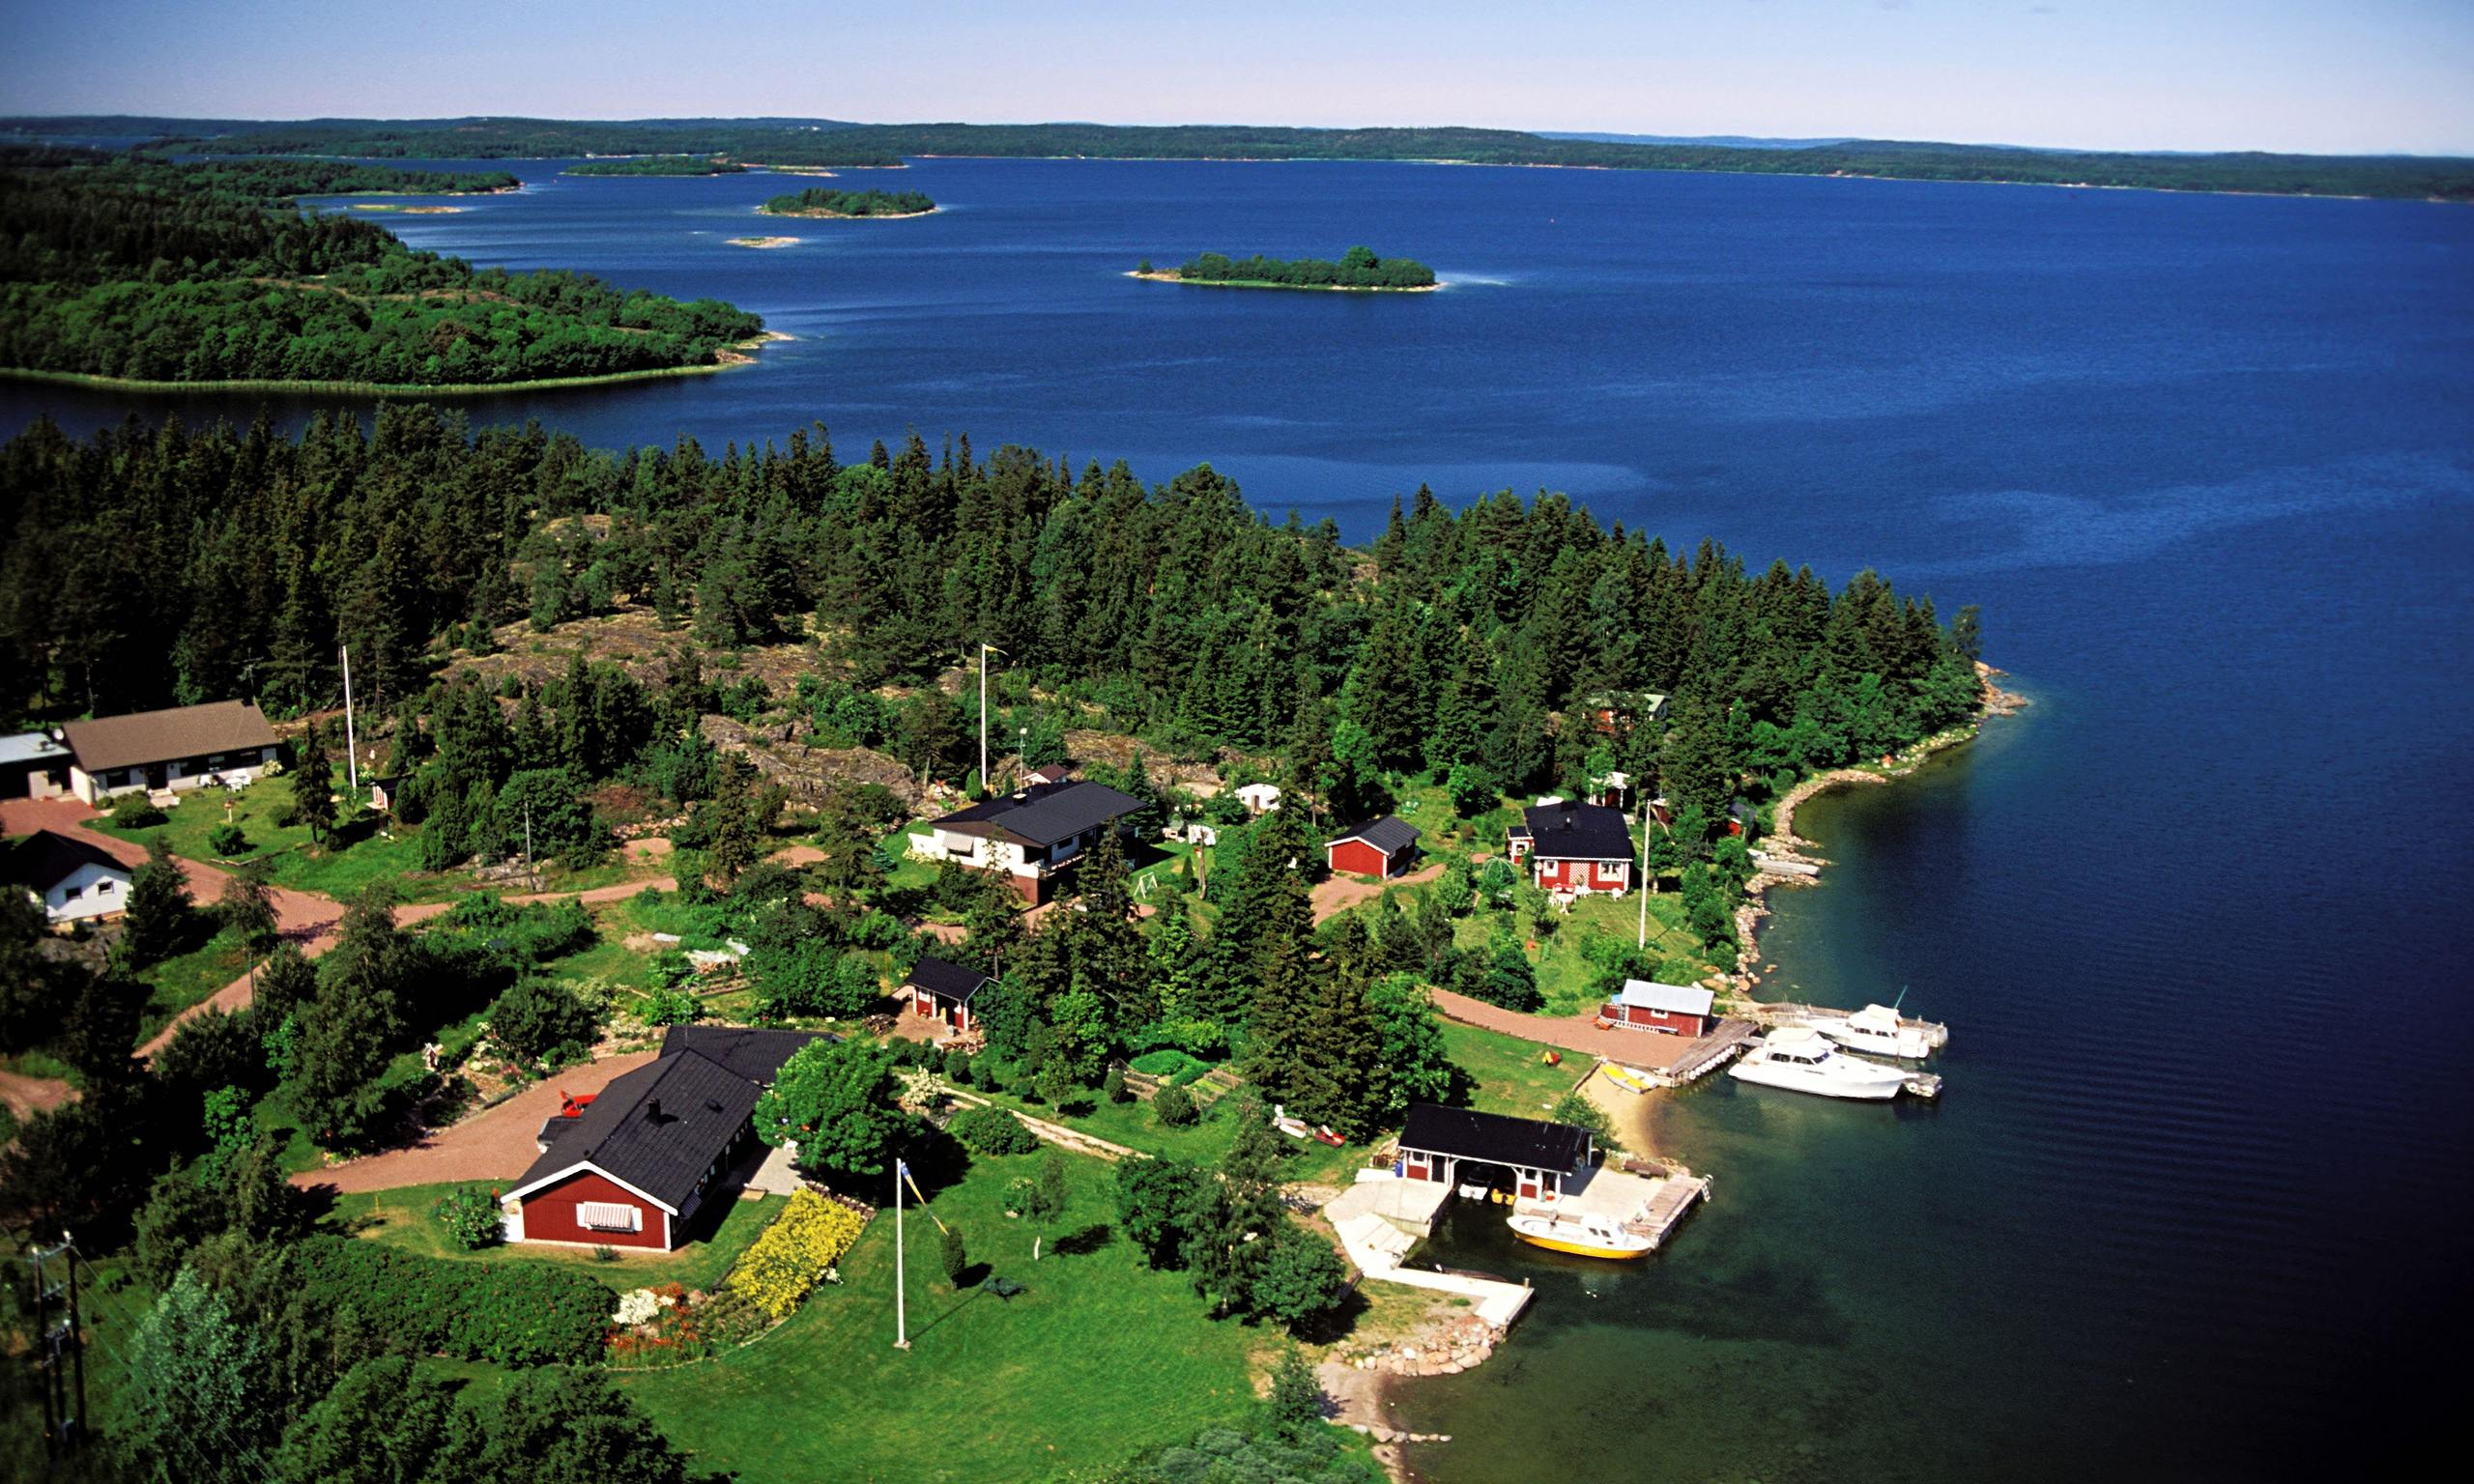

Slide 35
Upper Silesia, 1921
Upper Silesia, which contained a valuable industrial area, was located on the border between Germany and Poland.
Originally granted to Poland by the draft Treaty of Versailles, the Germans protested and it was agreed to hold a plebiscite(vote) in the region.
The overall results of the vote suggested it should be awarded to Germany but in some rural parts of the Silesian territory there was a clear majority in favor of Poland.

Slide 36
Upper Silesia, 1921
Following riots and protests the League suggested a partition, a decision which was accepted by bother sides.
Eastern Upper Silesia went to Poland while Western Upper Silesia went to Germany.

Slide 37
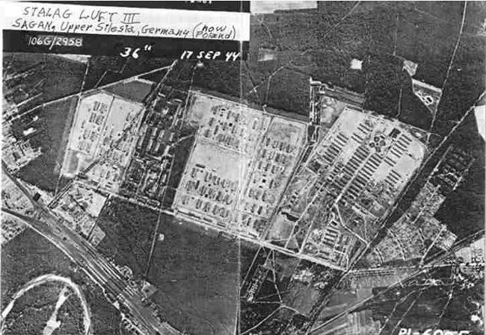

Slide 38
Mosul, 1924
In 1924 Turkey claimed the Kurdish-populated province of Mosul which was part of the British-mandated territory of Iraq.
The League investigated the problem and made an award in favor of Iraq.
Turkey accepted the judgment.

Slide 39
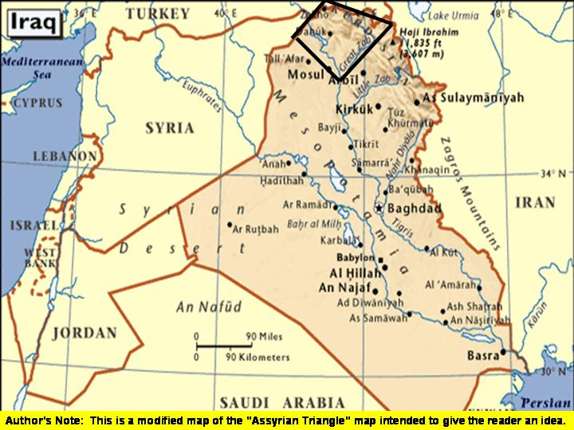

Slide 40
Bulgaria, 1925
In south-eastern Europe, Greece was ordered to pay £45,000 compensation to Bulgaria after its invasion of Bulgarian territory.
This was judged a disproportionate response to a shooting incident on the shared border in which Greek sentry was killed in an exchange of fire.
Greece accepted the ruling but felt it was unfair that Italy had been treated very differently and more generously in similar circumstances.

Slide 41
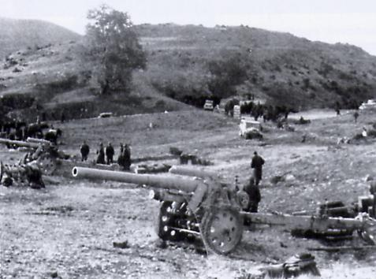

Slide 42
Successes of the League of Nations
Politically, in its early years the LON appeared to have made progress towards preventing war. But…
Washington Naval Agreement (1922)
The LON managed to reach an agreement between its 4 council members to limit the size of their navies.
Treaty of Locarno (1925)
Germany signed the Treaty of Locarno in which it agreed to accept its western boundaries, as set by the Treaty of Versailles, and also, the demilitarization of the Rhineland.
Kellogg-Briand Pact (1928)
Landmark agreement between 15 major countries, including Germany not to use “war as an instrument of national policy” and to pursue their goals through peaceful means. By 1933, 60 nations had made this promise.
Renounced
Ignored
Renounced
Persuade nations to disarm
Peace Treaty of Versailles, to uphold its terms (?)

Slide 43
How successful was the work of the League agencies?
The League was not simply concerned with the resolution of disputes.
It also attempted to identify those social economic and military issues that directly or indirectly affected the peace and wellbeing of the world – disease, poverty, exploitation, militarism, etc.
It was the task of the agencies, commissions and committees to address these problems and try to bring about improvements.
Some of the most important of these agencies are considered below.

Slide 44
How successful was the work of the League agencies?
The Agencies:
Refugee Organization
Health Organization
Economic and Financial Organization
International Labor Organization
Slavery Commission
Disarmament Commission

Slide 45
Successes of the League of Nations
Enhance Living and working Conditions
200,000 slaves were freed after the LON attacked slave traders in Africa and Burma. It repatriated ½ million prisoners of war.
The LON worked to prevent the spread of leprosy and malaria.
The league set up a system for regulating opium. It closed down four big companies that were selling drugs.
Organized conference to discuss monetary solutions to prevent economic collapse in 1920. Sent experts to help Austria and Hungary.

Slide 46
Refugee Organization

Slide 47
Refugee Organization
The Refugee Organization faced the problem of former World War One prisoners-of-war stranded principally in Soviet Russia, Poland, France, Germany and Turkey.
There was an estimated 250,000 Russians in German or French Camps and 300,000 Germans and former Austro-Hungarians in Soviet Russia.
In addition more than a million Greeks were made homeless during the Turkish War of Independence (1919-23).

Slide 48
Refugee Organization
The Norwegian explorer and scientist, Fridtjof Nansen, was given the responsibility of devising a solution to this challenge.
Despite the daunting scale of the problem, and with little more than a shoestring budget, Nansen and his staff worked alongside the Red Cross and helped 425,000 displaced persons either return to their homes or find new homes between 1920-1922.

Slide 49
Refugee Organization
Nansen’s methods involved a series of sometimes ingenuous improvisations – finding suitable transport, setting up camps, creating new settlements, teaching new trades and skills, issuing identity documents, etc.
It was an imaginative and logistical triumph that brought nothing but praise and thanks for the worked of the League.

Slide 50
Health Organization

Slide 51
Health Organization
Under the inspirational leadership of its Director, Ludwig Rajchman, this is regarded as one of the most successful of the League agencies.
It established links with non-member countries such as Germany, Soviet Russia and the USA to provide an information service, technical assistance and advice on public health matters.
In particular, it helped Soviet Russia prevent a typhus epidemic in Siberia in part by organizing a public education campaign on health and sanitation.

Slide 52
Health Organization
It also helped reduce the incidence of leprosy and begun an international campaign to exterminate mosquitoes, so reducing the spread of malaria and yellow fever.
The Health Organization was instrumental in setting up a number of research institutions based in London, Copenhagen and Singapore which developed internationally accepted vaccines for diseases such as diphtheria, tetanus and tuberculosis.
The success of the Health Organization was later demonstrated when, after the demise of the league, it became the World Health Organization affiliated to the United Nations.

Slide 53
Economic and Financial Organization

Slide 54
Health Organization
Following the end of the First World War, a number of countries faced economic crisis.
Austria, for example, was in danger of financial collapse as it tried to adjust to its new status as a small landlocked country now dependent upon agriculture for its wealth.
Expenditure had to be brought in line with the inevitably reduced revenues and in 1922 the League devised a rescue plan to achieve this.
Action was taken to stabilize the currency by controlling the level of interest rates, the circulation of banknotes, and the issuing of credit.

Slide 55
Health Organization
Austria was also given a substantial loan.
As a result of this trade soon revived, unemployment fell, and the budget was balanced.
Similarly successful rescue programs were devised for other ailing countries including Hungary, Greece and Bulgaria.

Slide 56
International Labor Organization

Slide 57
International Labor Organization
During the 1920s the ILO, under the direction of the French socialist Albert Thomas, achieved some success in pursuit of its main objective which was to bring about general improvement in working conditions.
It collected data on employment practices throughout the world, published the results and tried to persuade governments to take action by issuing recommendations.
These included the eight-hour working day and the forty-eight-hour working week, annual holidays with pay, the right to join trade unions, and a minimum employment age.

Slide 58
International Labor Organization
The ILO also published information on health and safety in the workplace, demonstrating that the use of white lead in print manufacturing was dangerous to health.
Inevitably the readiness of different countries to implement the recommendations was somewhat patchy.
For example, the recommended minimum age for employment was 15, yet even in Britain the school leaving age was not raised to that level until after the Second World War.
In the USA some employers were denying their employees the right to join trade unions until well into the 1930s.

Slide 59
International Labor Organization
Yet the ILO established and popularized a new series a new series of benchmarks with regard to work and employment.
It became increasingly difficult for member states to ignore the existence of enlightened work practices with regard to working hours, minimum wages, sickness and unemployment insurance and pensions.

Slide 60
Slavery Commission

Slide 61
Slavery Commission
The principal objective of the Slavery Commission was to stamp out slavery and slave dealing together with other exploitative practices such as forcing young women and children into prostitution – the “white slave” traffic.
Its methods were those of persistent enquiry, publication of reports, and the constant coaxing of government that appeared slow or evasive in taking effective action.
Successes included the freeing of 200,000 slaves in Sierra Leone and the reduction of the death rate for African workers engaged on the Tanganyikan railway from 50 percent to 4 percent.

Slide 62
Slavery Commission
A number of countries abolished slavery altogether such as Iraq, Jordan, and Nepal.
Yet the success was far from universal and the continued existence of slave trading was acknowledged in the Commission's report for 1937 while the ‘white slave’ traffic remains a serious social problem even in advanced countries, in the twenty-first century.

Slide 63
Disarmament Commission

Slide 64
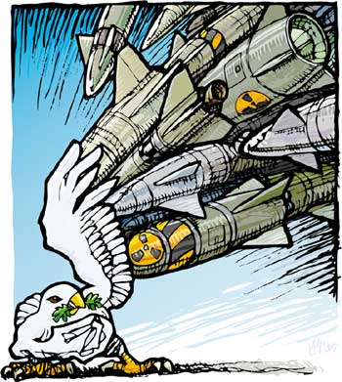
How Far did Hopes for Disarmament Succeed?
What is Disarmament?
Dismantling of armies and the breaking up of weapons to be in the position of making war impossible
Disarmament was part of collective security because if nations cut down their use of weapons, the world would be safer

Slide 65
Reasons for not Disarming
Britain:
The need to defend the Empire and to stop trouble in parts of the Empire seeking independence
France
Defend France from Germany
China
Civil War in progress and the need to defend China against Japanese advances

Slide 66
Reasons for not Disarming
Japan:
Power of the Japanese Army and the need to defend Japan against European land-grabbing in the Asia-Pacific
Switzerland
Army was small and only big enough to defend their neutrality
Poland
Need to defend their new country, especially from Germany and Russia

Slide 67
German Disarmament
Supervised by the League of Nations
Was slow and took advantage of several loopholes:
Trained its cut-down Army as officers so as to secretly train others to be ordinary soldiers

Slide 68
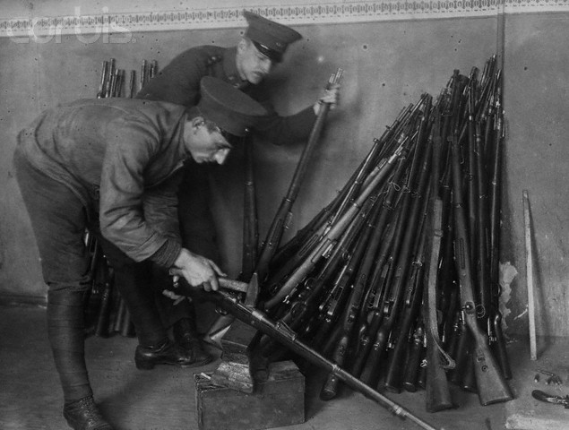

Slide 69
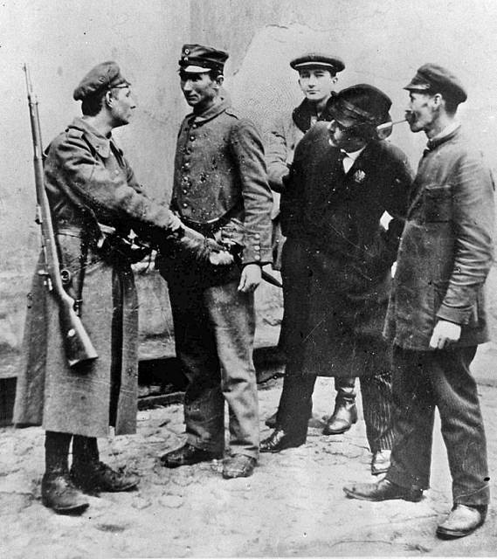

Slide 70
Disarming the rest of the World
Naval Disarmament
Targets set by agreeing to a ratio of shipbuilding between nations
Tensions between countries based on ratios allocated
Proportions were applied to all warships
Everyone could build submarines but at a low level

Slide 71
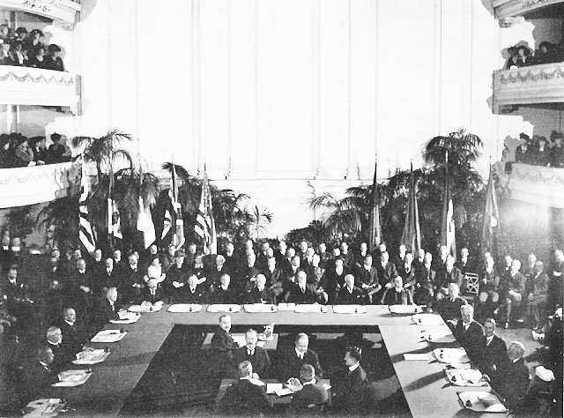

Slide 72
Disarming the rest of the World
Military Disarmament
1923 Treaty of Mutual Assistance
Countries would limit arms
League of Nations would come to their assistance
Very few agreed to the TMA
1924 Geneva Protocol
Nations would agree to bring disputes to arbitration instead of going to war
1928 Kellogg-Briand Pact
Signed by 65 nations
Promised no war over the next 5 years except in self-defense

Slide 73
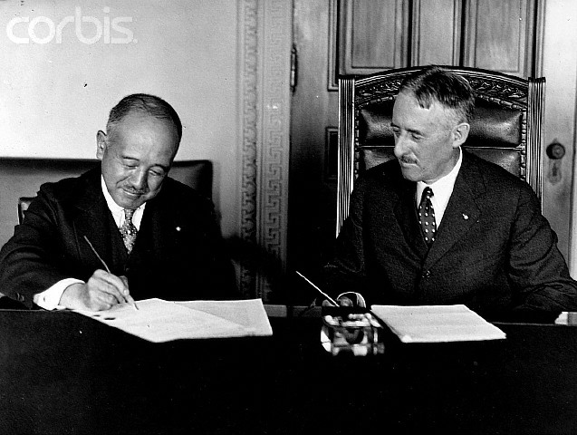

Slide 74
Homework: What work was carried out by the agencies of the League of Nations?

