Slide 1
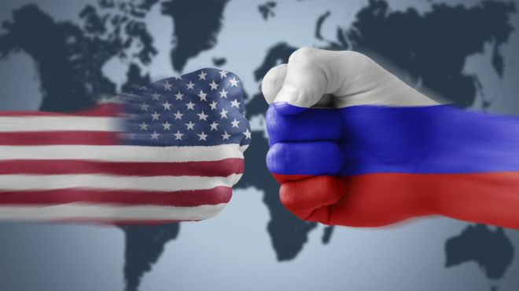
Chapter 6: How secure was the USSR’s control over Eastern Europe, 1948 – c. 1989?

Slide 2
What will we be studying this core topic?
Why was there opposition to Soviet control in Hungary in 1956 and Czechoslovakia in 1968, and how did the USSR react to this opposition?
How similar were the events in Hungary in 1956 and in Czechoslovakia in 1968?
Why was the Berlin Wall built in 1961?
Why were people Leaving?
What was the significance of “Solidarity” in Poland for the decline of Soviet influence in Eastern Europe?

Slide 3
What will we be studying this core topic?
What was the significance of “Solidarity” in Poland for the decline of Soviet influence in Eastern Europe?
How did Solidarity succeed where others had failed?
The return of Solidarity
How far was Gorbachev personally responsible for the collapse of Soviet control over Eastern Europe?
The role of Golbachev
Actions in Eastern Europe
The role of other countries
Who was responsible for the collapse of Soviet power?

Slide 4
Introduction
The Soviet union had been on the winning side in the Second World War. As victors, they had three main aims for Europe:
To create a buffer zone to the west of Russia, protecting them from any attack in the future.
To spread communism
To use the resources of others to help rebuild to help rebuild their war-damaged country.
Communist rule was gradually established across Eastern Europe as Soviet forces established control there.

Slide 5
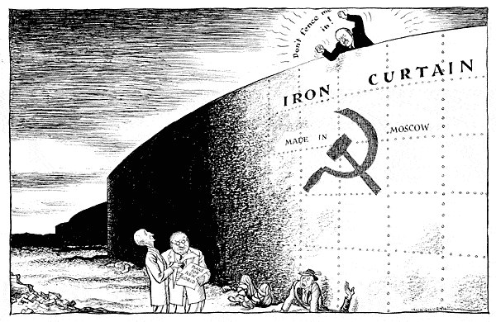

Slide 6
Introduction
Through heavily supervised elections a communist ruling party was established in each country with orders coming straight from Moscow. This “Iron Curtain”, as it came to be known, separated Europe into two sides.
The Soviet-controlled countries in the East were tied by two binding agreements.
An economic agreement was put in place in 1949 with creation of COMECON, the Council for Mutual Economic Assistance.
The Warsaw Pact set up in 1955 was mutual defense treaty between the eight communist states of Eastern Europe, with each country agreeing to support any of the others if attacked.

Slide 7
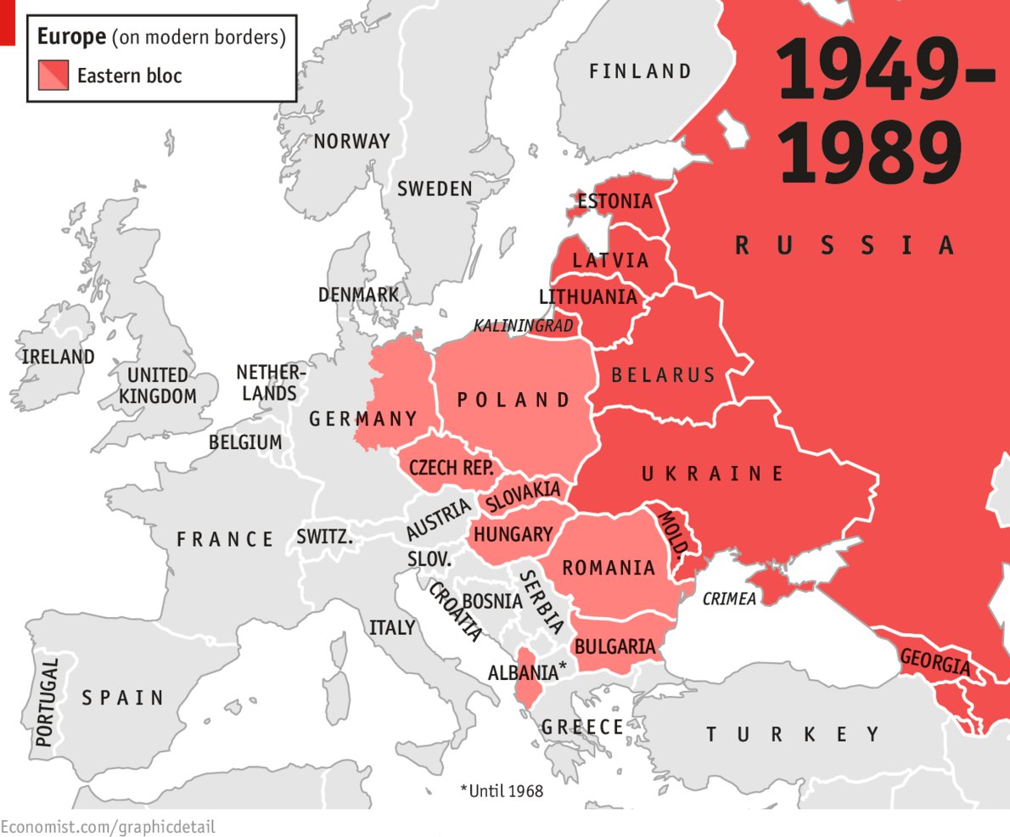
Eastern Europe Warsaw Pact Members

Slide 8
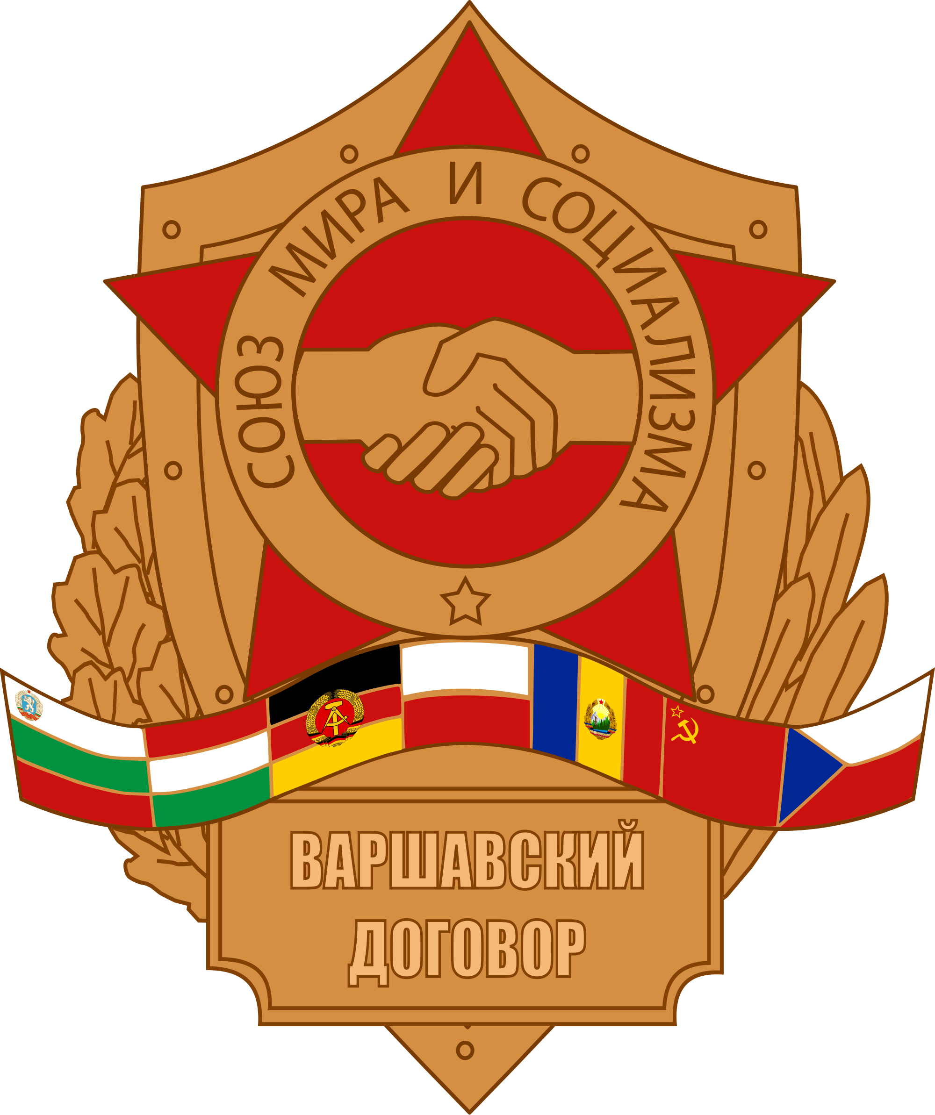
Why was there opposition to Soviet Control in Hungary in 1956 and Czechoslovakia in 1968, and how did the USSR react to this opposition?

Slide 9
Background
After WW2 Hungary was again on the losing side (also during WW1). Due to originally joining the war alongside the Axis Powers, fighting with Nazi Germany and against the Soviet Union.
In 1941 when Germany attacked Russia part of the forces during the invasion was Hungarian troops.
However by the end of the war Hungary was under Soviet Control and formed part of the Eastern bloc.
Hungary became a satellite state of the Soviet Union. The ruling party received orders from Moscow.

Slide 10
Background
This lead Hungary to become a Communist country.
In 1955 Hungary was one of the countries that signed the Warsaw Pact, a military treaty linking the Eastern European communist countries to the Soviet Union.

Slide 11
What caused the rebellion of 1956?
There was long-term anger about the influence of Soviet rule and deeply unpopular communist policies.
Please remember during ww1 Germany and Austria-Hungary had an alliance and both countries hated Russia.
Then in WW2 Hungary went with Germany against Russia.
Now Hungary is part of Soviet Union (which is lead by Russia)

Slide 12
What caused the rebellion of 1956?
Politics: Elections had been held after the end of the Second World War. The Smallholders Party, a group working for the rights of ordinary Hungarians, won 57 percent of the votes.
The Russians, however refused to allow the part to form a government, and instead allowed the Hungarian Communist Party to form a government with only 17 percent of the votes.
Form this point on they were the party to run Hungary, despite the people’s wishes.

Slide 13
What caused the rebellion of 1956?
Repression: Russian control of Hungarian society included censorship, a secret police (the AVH), and control over what schools taught.
An estimated 2,000 people were executed and over 100,000 were imprisoned as the Russians took strict control over Hungary.

Slide 14
What caused the rebellion of 1956?
Religion: The Hungarians were religious but under the Communist Party religion was banned and dismissed as “dangerous propaganda”.
Cardinal Joseph Mindszenty, a leading Hungarian Catholic, was arrested, tortured, and put in prison.

Slide 15
What caused the rebellion of 1956?
Economics: After the war Hungary was very poor and, like a lot of Europe, needed rebuilding after years of bombing and damage.
Yet much of the food produced as well as industrial goods were set instead to Russia.
This meant that standards of living dropped for ordinary people.

Slide 16
What caused the rebellion of 1956?
All these factors meant that there was a great deal of resentment of Soviet rule among Hungarians. In 1956 things reached a critical point; the Hungarian people thought change might be possible for the following reasons:
Hungarians thought that the United Nations or the new American president, Eisenhower, would help them after he made supportive comments in speeches.

Slide 17
What caused the rebellion of 1956?
Stalin had died in 1953. With his death, Russia had tried to move away from some of his policies, including the more brutal aspects. The new leader, Nikita Khrushchev, refused to allow the arrest of 400 political opponents in Hungary.
In 1956 workers in Poland had risen against Soviet rule and demanded change. After a tense few weeks, Russia had given in to some of their demands. This gave people hope in Hungary that the same could happen there.

Slide 18
What caused the rebellion of 1956?
The uprising begins:
23 October 1956: Students in Budapest demanded an end to Soviet occupation and the implementation of “true socialism”. The police made arrests. When the students attempted to aid those who had been arrested, the police opened fire on the crowd. In a symbolic gesture, a 30-foot statue of Stalin was toppled by protestors.

Slide 19
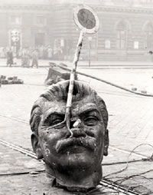
What caused the rebellion of 1956?

Slide 20
What caused the rebellion of 1956?
The uprising begins:
24 October 1956: Overnight Russian troops had been sent in to stop and protests. Soviet tanks were stationed outside the Parliament building and Soviet soldiers guarded key bridges and crossroads.
Despite this, Hungarian soldiers and workers joined the students on the streets of Budapest. The Hungarian Communist Party appointed a new Prime Minister, Imre Nagy. He asked Khrushchev to remove Russian troops from Hungary and promised the people free elections.

Slide 21
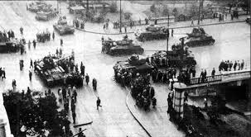
What caused the rebellion of 1956?

Slide 22
What caused the rebellion of 1956?
The uprising begins:
25 October 1956: A large number of protesters gathered in front of the Parliament building. Those politicians loyal to Russia were forced to flee as the protestors took control of the running of the country. Nagy continued as Prime Minister, still promising reform.
28 October 1956: Keen to avoid bloodshed, Khrushchev agreed to the demands of Nagy to remove troops and the Russian army pulled out of Budapest.

Slide 23
What caused the rebellion of 1956?
The uprising begins:
29 October – 3 November: The new Hungarian government introduced democracy, freedom of speech, and freedom of religion. Cardinal Joseph Mindzenty and other political prisoners were released from prison. Nagy also announced that Hungary was going to leave the Warsaw Pact. On 1 November he appealed to the UN for help in resolving the conflict.

Slide 24
What caused the rebellion of 1956?
The uprising begins:
4 November 1956: One thousand Russian tanks moved into Budapest. They almost immediately captured Hungary’s airfields, highway junctions, and bridges. Fierce fighting took place but Russian force was too strong for the Hungarian army and protestors.
The new leader of Hungary, Janos Kadar promised Nagy and his followers that they would be allowed to leave the country safely. Three weeks later they were kidnapped, tried and eventually executed for treason.

Slide 25
Czechoslovakia

Slide 26
Czechoslovakia
In 1968 the “Prague Spring” began with the government of Czechoslovakia attempting to make reforms, improve the country, and lessen the ties to Soviet Russia.
In ended with a Russia invasion, a new enforced leader and a halt to all reforms.
Much like Hungary, Czechoslovakia had fallen under Soviet rule after the end of the Second World War.
Tight controls had been established on the way the country was run, how the economy was structured, and the rights people had.

Slide 27
What caused the demand for reform?
Throughout the 1960s the Czechoslovakian economy struggled.
After suffering a recession during which Czech industry struggled to produce goods to sell and the standard of living for ordinary people dropped, several changes were made.
The most important of these was loosening of government controls on businesses, meaning that companies could now have more control over setting prices and wages.
This was very different to communist rule.

Slide 28
What caused the demand for reform?
Proposed reforms included the following:
The abolition of censorship, the press could now print what they wanted to started to report revelations about corruption in high prices.
Freedom of speech, citizens had the right to criticize the government.
Members of the party were not to be unconditionally loyal to the party, but instead be honest about how the country was run. The reforms stated that each member “has not only the right, but the duty to act according to his conscience.”

Slide 29
What caused the demand for reform?
Proposed reforms included the following:
The creation of workers’ councils in industry.
Increased rights for trade unions.
Rights for farmers to form independent farms away from state control.
Freedom of movement for all people

Slide 30
What caused the demand for reform?
The government of Czechoslovakia know that these reforms would be seen as potentially dangerous by Moscow, and fearing a situation like that in Hungary where troops had entered the country, publicly declared that Czechoslovakia had no intentions of changing its foreign policy, leaving the Warsaw Pact or ending its alliance with the Soviet union.
This was meant to reassure the USSR and avoid the need for intervention from Moscow.

Slide 31
Soviet Response
In July 1968 the Soviet leadership announced that it had evidence that West Germany was planning an invasion of the Sudetenland and asked permission to send in the Red Army to protect Czechoslovakia.
Dubcek refused.
However, Soviet's, invaded Czechoslovakia. Knowing they stood no chance the Czech government ordered its armed forces not to resist the invasion.

Slide 32
Soviet Response
The culture of reform known as the “Prague Spring” was crushed.
Alexander Dubcek was taken to Moscow and soon afterward announced that Czechoslovakia would be abandoning its reform program.

Slide 33
Soviet Response
The leader of the USSR, Leonid Brezhnev, was worried that the new ideas coming out of Czechoslovakia would spread.
Other leaders in Eastern Europe feared that their own people would demand the same freedom that Dubcek had allowed in Czechoslovakia.
Incidentally, in 1968 Albania resigned from the Warsaw Pact because it thought the Soviet Union itself had become too liberal since Stalin had died.

Slide 34
Soviet Response
To stop this from repeating the Brezhnev Doctrine was introduced.
This Soviet foreign policy stated that communist countries should be mindful of how their actions impacted on the other communist states.
Communist countries therefore would be governed by two principles:
A one-party system in each country
All countries were to remain members of the Warsaw Pact.
If these conditions were not met, under the terms of the doctrine, the USSR could use military force to re-establish control.

Slide 35
Soviet Response
In April 1969 Alexander Dubcek was replaced as party secretary, expelled from the party and spent the next two decades working as a clerk in a lumber yard in Slovakia.
The invasion ushered in a 20 year period of so-called “normalization”.

Slide 36
Question
During the reforms Dubek placed great emphasis on the fact that Czechoslovakia didn’t want to break form Soviet control.
Why do you think he was keen to do this?
Why ere the Soviets frightened of the proposed reforms in Czechoslovakia?

Slide 37
How similar were events in Hungary in 1956 and in Czechoslovakia in 1968?
 | How were events similar? | How were they different?
Causes
Aims of the rebels
Actions of the people

Slide 38
How similar were events in Hungary in 1956 and in Czechoslovakia in 1968?
 | How were events similar? | How were they different?
Why the Soviet Union intervened
How each state responded to Soviet intervention
Reaction of the wider world

Slide 39
How similar were events in Hungary in 1956 and in Czechoslovakia in 1968?
 | How were events similar? | How were they different?
Causes | Both countries had a long-term resentment Soviet rule | Hungary was affected by issues in other countries: the rebellion in Poland inspired them to act. Czechoslovakia was affected by issues at home: economic depression and a desire for political change.
Aims of the rebels | Both wanted to give their people more rights and lessens the control of the communist state. | In Hungary these change included withdrawing from the Warsaw Pact and Soviet influence. Czechoslovakia did not want to go that far.
Actions of the people | Both involved groups of people protesting. | In Czechoslovakia, the people’s actions were largely started by the role of their leader. It was his changes that encouraged them to protest. In Hungary, it was the people who acted first.

Slide 40
How similar were events in Hungary in 1956 and in Czechoslovakia in 1968?
 | How were events similar? | How were they different?
Why the Soviet Union intervened | The Soviet Union was very suspicious and fearful that any form of rebellion/change would spread and lead to a split in its control in other countries. | The political nature of Czechoslovakia was particularly dangerous for the Soviets; they had faced people-led rebellions before like that in Hungary, but the “Prague Spring” was started by people who were meant to be under Soviet Control.
How each state responded to Soviet intervention | Both leaders were removed from office. Both resulted in mass emigration. | In Hungary the people armed themselves and fought when the Soviets attacked. In Czechoslovakia, following orders from he government, the people did not fight back. In Czechoslovakia there were several protests after the Russian invasion including suicides.

Slide 41
How similar were events in Hungary in 1956 and in Czechoslovakia in 1968?
 | How were events similar? | How were they different?
Reaction of the wider world | Reactions to both were wholly negative Soviet use of force. The situation in Hungary was discussed at the United Nations; with Czechoslovakia the Soviet actions were condemned by different countries including the USA. | With the Czechoslovakian invasion some members of the communist Warsaw Pact expressed shock at Soviet actions. The Romanian leader complained about Russian intervention.

Slide 42
Discussion
Which act of resistance achieved the most?
Which would have been viewed as more dangerous at the time?
Which would you view as more dangerous now, knowing all the information?

Slide 43
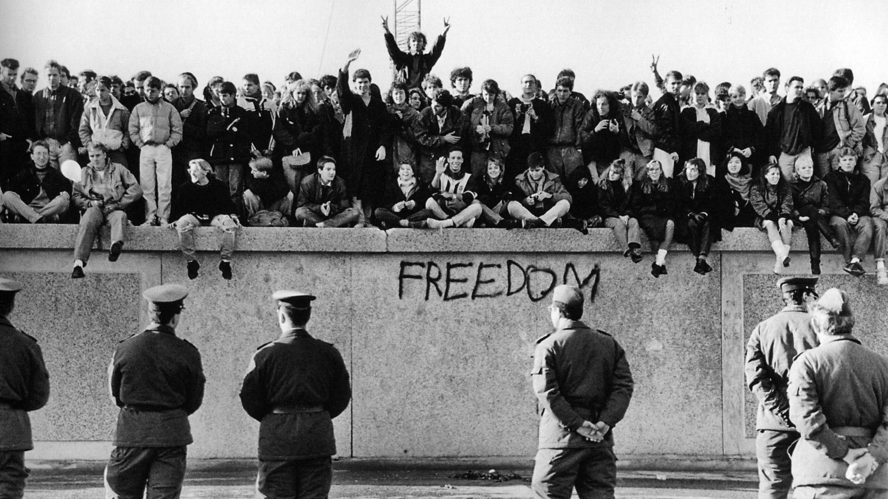

Slide 44
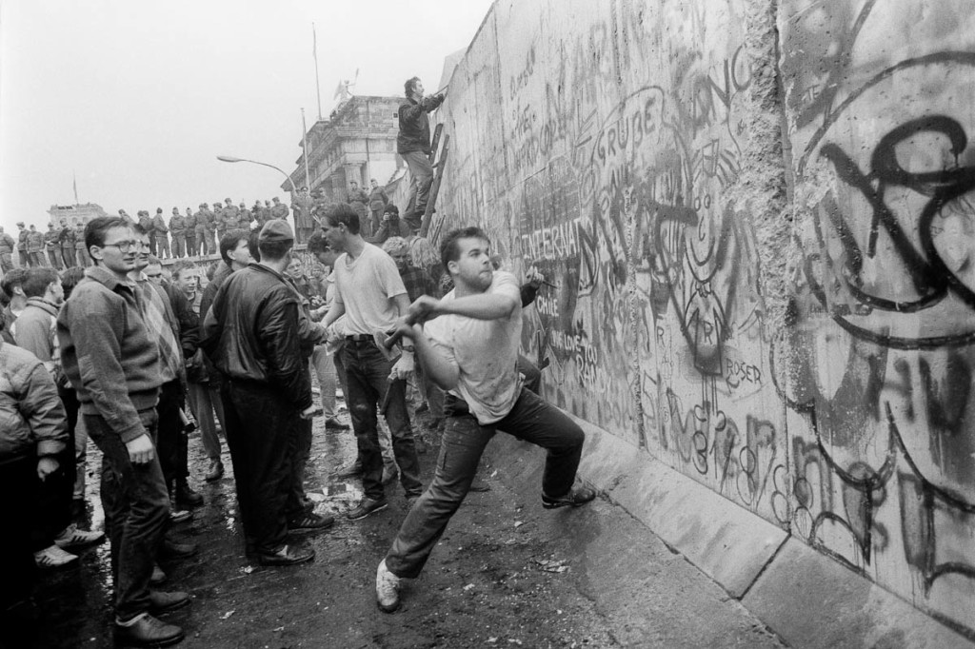

Slide 45
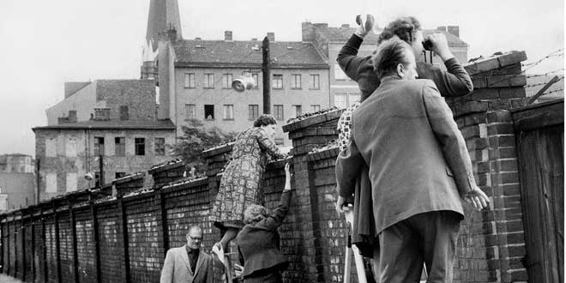

Slide 46
Why was the Berlin Wall built in 1961?
On 13 August 1961 the people of Berlin woke to find that their city had changed.
Berlin, the center of the Cold War since the division of Germany in 1945, was now city of two halves, divided by a wall 87 miles long that separated East from West.
The wall was a surprise to most people as the leader of East Germany, Walter, had stated only two months before “No one has the intention of erecting a wall”.

Slide 47
Why was the Berlin Wall built in 1961?
Despite this claim less than two months later East Germany, under instruction from Soviet Russia, built the wall.
The erection of the wall by the East was to prevent the mass movement of people from East to West.
Nearly 2.6 million East Germans had left for West Berlin or West Germany between 1949 and 1961, some 15 percent of the population.

Slide 48
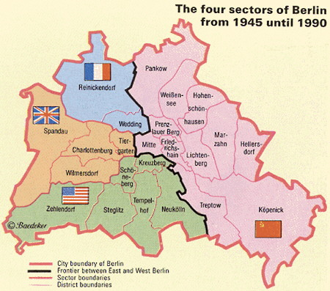
The division of Berlin

Slide 49
Why were people leaving?
The quality of life in the West was much better than in the east after 1948.
While West Germany had received financial help through the Marshall Plan from the USA to rebuild after the devastation of suffered under a communist system after the Second World War.
East Germany had suffered under a communist system after the control of the Soviet Union had been establish.

Slide 50
Why were people leaving?
The impact of the mass movement on East Germany was huge.
Socially: Those leaving tended to be young and well-educated. The Communist Party in East Germany feared a “brain drain” as the more intelligent left East Germany.
Economically: East Germany lost too many skilled workers. By 1960 only 61 percent of its population was of working age, compared to 70 percent before the war. Engineers, technicians, physicians, teachers, lawyers, and skilled workers were all leaving in high numbers.

Slide 51
Why were people leaving?
Politically: The mas numbers leaving made the communist regime look unpopular. In the context of the Cold War, this was negative propaganda as they competed with the capitalist West.
As the effects of the emigration continued, the East German government saw no other way to prevent people form escaping to the West via berlin than to close the border between East and West Berlin.
At first barbed wire was used but on August 13th, 1961 the first wall was built.

Slide 52
Reaction of the West
The reaction of the western allies was muted.
Why do you think this is?
Their own interests were not affected; they could still send troops to West Berlin and the wall made an attempt by invasion from the East less likely.
Crucially, it was also great propaganda for the Cold War; the West could claim to be the side allowing people freedom while the communist states had to erect a wall to keep people in!

Slide 53
Reaction of the West
Let’s now look at page 124 in your book.
Let’s read source 11, 12 and 13.
Discussion:
Study sources 11 and 12. Which source can you trust more?
What reasons do the communist governments give for construction of the wall?
Why was source 13 published at the time?
“there is no value in using such sources to study an event as they are so obviously biased.” How far do you agree with such a statement regarding Sources 11 – 13?

Slide 54
What was the significance of “Solidarity” in Poland for the decline of Soviet influence in Eastern Europe?

Slide 55
Background
In July 1980, the Polish government was facing an economic crisis.
The country was short of money so was forced to raise the price of goods while at the same time imposing a limit on any rises in wages.
Ordinary people faced extreme poverty which was way too much for many of Poland’s workers and strikes spread almost at once across the country.
From these strikes developed a movement of workers which is seen by some as being part of the downfall of the control of the Soviet Union.

Slide 56
What happened?
On August 14, 1980, workers at the Lenin Shipyard in Gdansk went on strike, angry at the recently announced price rises and the dismissals of several workers who had complained about poor conditions.
The strikers were led by Lech Walesa, an electrician.
The strike lasted for a week before Communist Party negotiators arrived to begin talks with the strike committee.
Despite the best attempts of the Communist government to isolate the strikers by cutting the telephone lines and censoring news reports, the workers received support from across the country.

Slide 57
What happened?
By the time the negotiations began the workers had a list of 21 demands.

Slide 58
Some of the demands made by the strikers
1. Acceptance of free trade unions independent of the Communist Party and enterprises.
2. A guarantee of the right to strike and of the security of strikers and those aiding them.
5. Availability to the mass media of information about the formation of Inter-factory Strike Committee and publication of its demands.
8. An increase in the base pay of each worker by 2,000 zlotys a month as compensation for the recent rise in prices.
10. A full supply of food products for the domestic market, with exports limited to surpluses.
12. The selection of management personnel on the basis of qualifications, not party membership. Privileges of the secret police are to be eliminated.
19. A decrease in the waiting period for apartments.
21. A day of rest on Saturday.

Slide 59
What happened?
On August 31st an agreement was signed meeting some of the demands.
Crucially it gave workers the right to form unions independent from government control.
Two weeks later a nationwide independent trade union called “Solidarity” was established.
On December 13, 1981 the government declared a “state of war” and suspended Solidarity.

Slide 60
How did Solidarity succeed where others had failed?
Why did the Polish government agree to the demands of its workers while protest in other Soviet-controlled countries had failed.
Organization: The movement had a committee, spokespeople, and even a newspaper, the Solidarnosc. Printed on the shipyard printing press, it enabled them to spread their message.
Demands: Their 21 demands were national issues, not just local ones. By doing this they secured the support from a range of the population and affected the most important industries in the country.

Slide 61
How did Solidarity succeed where others had failed?
Methods: The movement was careful never to use violence for fear of encouraging harsh punishments from the government.
Support: Between 1980 and 1981, 10 million people from all aspects of Polish life – students, workers, intellectuals – joined the trade union. Some 80% of Poland’s workforce were members.
The government, having allowed the reforms to exist, now sensed that public mood had calmed and took action to reassert control.

Slide 62
How did Solidarity succeed where others had failed?
The newly elected Prime Minister of Poland, Wojciech Jaruzelski, invited Walesa to meet to discuss his role in the new government.
These discussions were a cover up though, as Jaruzelski had no intention of working with Welesa.
Instead on December 13th, claiming to have recordings of Solidarity leaders planning a coup, Jaruzelski proclaimed martial law and Solidarity was outlawed.
The military arrested most of Solidarity’s leaders, including Walesa.
It appeared that the move towards reform in Poland was move.

Slide 63
Homework
One – two page report/essay on the topic of:
What was the significance of “Solidarity” in Poland for the decline of Soviet influence in Eastern Europe?
You can’t use your book only sources online. You need to cite your sources.
The assessment rubric is on the next slide.

Slide 64
Homework Rubric
Level | Marks | Description
5 | 36-40 | Candidates demonstrate and select and effectively deploy relevant and accurate contextual knowledge.
 |  | Candidates select a wide range of relevant information which is well organized and deployed effectively.
 |  | Candidates demonstrate excellent understanding of the significance of the key features, reasons, result or changes of societies, events, beliefs, people and situations studied with good awareness of the importance of interrelationships and the broad context.

Slide 65
Short Test ☺
How had the Soviet Union gained control of Eastern Europe?
What was the Warsaw Pact?
Why didn’t the United Nations or any eastern country intervene to support Hungary?
Why were the Russians so against the idea of reforms in Hungary?
What was Prague Spring?

Slide 66
How far was Gorbachev personally responsible for the collapse of Soviet control over Eastern Europe?

Slide 67
Changes in Eastern Europe | Date | Changes in Russia
 | 1985 | Mikhail Gorbachev becomes leader of the Soviet Union
 | 1986
 | 1989 January | Soviet troops withdraw from Afghanistan
Poland becomes independent | June
Hungary becomes independent | September
Berlin Wall is removed and East Germany allows free movement | November
Communist governments fall in Czechoslovakia, Bulgaria and Romania | December

Slide 68
Changes in Eastern Europe | Date | Changes in Russia
 | 1990
Lithuania becomes independent | March
 | May | Boris Yeltsin was elected as President of Russia
Germany reunited | October
 | 1991
 | May | End of the Soviet Union

Slide 69
How far was Gorbachev personally for the collapse of Soviet control over Eastern Europe?
When Lithuania became independent in 1990 the Soviet Union’s control over Eastern Europe was nearly over.
Forty-five years of communism ended as for the first time countries elected their own democratic governments.
Why did this collapse take place?

Slide 70
The role of Gorbachev
When Mikhail Gorbachev was elected ruler of the Soviet Union, he set about reforming the country.
Realizing the need for change, he set about driving the Soviet Union forwards.
His major changes included attempting to modernize the Soviet Union’s economy as well as attempting to tackle corruption and alcoholism.
There were two key policies: glasnost and perestroika.

Slide 71
Glasnost
The policy was social and political reforms that Gorbachev introduced.
These included the following:
More freedom for the media
Allowing news to be transmitted of government corruption and criticism of government officials.
This was all about transparency or “openness” to society in the Soviet Union, allowing more people to be involved in the political process through freedom of expression.

Slide 72
Glasnost
Gorbachev tried to encourage this by revealing parts of Russia’s past that had previously been hidden, such as details about more brutal parts of Stalin’s rule.
This was something new to the Soviet Union.

Slide 73
Perestroika
The second policy was known as perestroika, meaning “restructuring”. This lead to a series of economic, political, and cultural reforms that aimed to make the Soviet economy a more modern and efficient system. This included:
Encouraging the private ownership of Soviet industry and agriculture.
Reducing state control over imports and exports.
Allowing trade with non-Eastern bloc countries.
Allowing foreign investments in Russian businesses.
An increase in the production and trade in consumer goods.

Slide 74
Actions in Eastern Europe
Gorbachev’s policies of promoting “openness” through glasnost applied not only within Russia; he realized that Eastern Europe must be allowed to choose its own destiny.
Gorbachev made it clear he would not stand in the way of attempts at democracy in Warsaw Pact countries, and that, unlike in the past, troops would not be used to keep countries tied to the Soviet Union.

Slide 75
Actions in Eastern Europe
There were three key reasons for this change.
Gorbachev was a reformer. He believed the Soviet Union was out of date in controlling others and that people should be allowed a say in who ruled them.
Economically, the union was crumbling. Food shortages were so common that by the end of the 1980s the wartime system of food cards had been reintroduced.
Gorbachev saw his main priority as reforming Russia. To do this he couldn’t be focused on maintaining control of Eastern Europe. The Soviet Union could no longer afford to maintain the military presence needed to control its European satellite states.

Slide 76
The role of other countries
The independence movement in some Eastern European countries was growing. Gradually people pressure forced the changes through.
Poland: The Solidarity movement had shown that a unified and largely peaceful movement which wanted reform could succeed.
Hungary: Parliament adopted a “democracy package”, which included trade union rights, personal freedoms, a less restricted press, more voting rights, and acknowledgement that the uprising of 1956 was a popular movement not a foreign insurgency.

Slide 77
The role of other countries
East Germany: Mass emigration through newly opened borders raised the hope of change. When the government there moved to repress a popular movement, a visit by Gorbachev inspired the movement as he urged the Communist Party there to reform. One night by accident an official declared an end to the restrictions on travel. With this crowds gathered and the Berlin Wall was torn down. Germany unified a year later.

Slide 78
The role of other countries
Romania: Leader Nicolae Ceausescu had stated he intended to see off any anti-communist protests, but while he was out of the country his people began to protest. Ceausescu ordered the protestors to be fired upon. The military refused and Ceausescu was forced to flee. Free democratic elections were held in 1990.

Slide 79
The role of other countries
Between the spring of 1989 and the spring of 1991 every communist or former communist Eastern European country held democratic parliamentary elections for the first time in years. Soviet Union control was over.

Slide 80
External Factors
It wasn’t just the actions of Gorbachev through that lead to the collapse of Soviet control; there were also wider issues.

Slide 81
The war in Afghanistan
In what was originally an attempt to take control of the country, the Afghan militia, the Mujahideen, managed to engage the Soviets in what became a guerrilla-style war in 1979.
The war badly overstretched their economy and demoralized their military. The war led to widespread condemnation by other coutnries and pressure to withdraw.

Slide 82
The role of the USA
The new ruler in Russia was not the only person who wanted change. President Ronald Reagan also sought to encourage an end to the Cold War.
Together, Reagan and Gorbachev signed treaties to limit nuclear weapons and also encouraged people-led movements in Eastern Europe.
Reagan had another impact as well: by increasing military spending by a third in the USA the Soviet Union felt they could not respond in the “arms race”. This meant the Soviets needed to find another way of securing peace, this time through diplomacy.

Slide 83
Who was responsible for the collapse of Soviet power?
To see Gorbachev as solely responsible is perhaps too simplistic.
What Gorbachev did do was to create a climate in which people could make changes for themselves.
He allowed the freedoms and the rights in Russia first, then elsewhere.
The rest was done by popular movements, who for the first time were unshackled to allow them to seize power.

Slide 84
Question for 10 points
Please pick 2 questions and answer it.
5 points per a question
What caused the demand for change in Czechoslovakia?
Why were people leaving East Berlin up to 1961.
Explain Gorbachev’s attitude to Eastern Europe?

