Slide 2
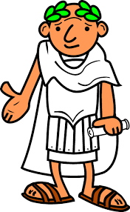
What things a city/state needs to operate and keep people happy?

Slide 3
KWL Chart
Now we will take a look at the poster on the side of the class.
Each of you will be given 3 sticky notes:
Each of you will have a choice to write 2 sticky notes for K (What do you know?) and one for W (What do you want to find out?). Or you can do 1 sticky note for K and two for W. It is your CHOICE!
Everyday at the end of the lesson you will fill in a sticky note for L (What did you learn?)

Slide 4
Reading Activity
You now need to read “Romulus and Remus: The Founders of Rome” and answer the 3 questions provided.

Slide 5
Reading Activity
You now need to read “Romulus and Remus: The Founders of Rome” and answer the 3 questions provided.
What do you think of the story?

Slide 6
Map Activity
Now we will make a map of Ancient Rome: The Italian Peninsula.
Throughout this unit you will make multiple maps and learn about different geographical terms.
Make sure you color it in and make a legend of what each color means.

Slide 7
Geography of the Roman Empire
If you look at a map, the Italian Peninsula seems a logical place for the emergence of a mighty Mediterranean empire.
The boot-shaped peninsula juts south from Europe far into the Mediterranean.
It also lies almost halfway between the eastern and western boundaries of the Mediterranean Sea.

Slide 8
Geography of the Roman Empire
Italy’s physical features aided the growth of a powerful civilization.
To the north, the peninsula was protected, though not isolated, by the high mountains of the Alps.
To the south, east, and west, the sea provided both protection and a means of rapid transportation.
Much of the peninsula had rich soil and a mild climate, able to support a large population.

Slide 9
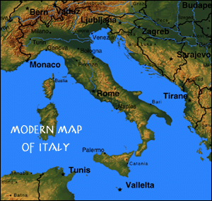
Geography of the Roman Empire

Slide 10
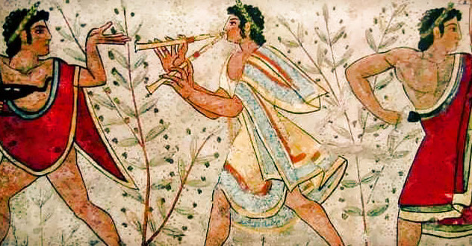
The Etruscans

Slide 11
The Etruscans
At first Rome was ruled by Latin kings. Around 616 BC, however, it came under the rule of the Etruscans of northern Italy.
From evidence found at Etruscan cemeteries, scholars believe that they were great metalworkers and jewelers whose culture had been heavily influenced by Greece.

Slide 12
Rome Becomes a Republic
According to ancient historians, the Etruscans ruled Rome until 509 BC, when the Romans revolted and threw out the last king, a tyrant.
In place of the monarchy, the Romans established a new type of government a republic, in which elected officials governed the state.

Slide 13
Patricians and Plebeians
In the early days of the Republic, the heads of a few aristocratic families, known as patricians, elected officials from among themselves.
Organized in clans, patrician families controlled every aspect of society—politics, religion, economics, and the military.
Patricians maintained their power through a patronage system in which wealthy Romans provided financial, social, or legal support for lower ranking families in return for political backing and loyalty.

Slide 14
Patricians and Plebeians
Almost from the beginning of the Republic, however, the common people, or plebeians (pli-bee-uhns), challenged the patricians for power.
When invaders threatened Rome in 494 BC, the plebeians seceded, or withdrew.
They left Rome and refused to fight until changes were made.

Slide 15
Patricians and Plebeians
Realizing that they would not have an army without the plebeians, the patricians grudgingly expanded plebeian rights.
Once they received these new rights, the plebeians returned to defend the city.
Back in Rome, they formed their own assembly, the Plebeian Council.
That assembly had the responsibility of overseeing and protecting plebeian affairs.

Slide 16
Patricians and Plebeians
To guarantee their rights, the plebeians also gained the right to elect officials known as tribunes.
It was the tribunes’ job to protect the plebeians against unjust treatment by patrician officials.
Eventually, these tribunes even gained the right to veto, or ban, laws that seemed harmful or unjust to the plebeians.

Slide 17
Patricians and Plebeians
Later, around 450 BC, the plebeians forced the patricians to have all laws written down.
The laws were displayed in the Roman Forum, or central square, on 12 large bronze tablets.
As a result, the code became known as the Law of the Twelve Tables.
Because the laws were posted, patrician judges could not make decisions based on their own opinions or on secret laws.
However, one of the newly posted laws was a ban on marriage between patricians and plebeians—an attempt by the patricians to preserve their special status.

Slide 18
Republican Government
Working together, the patricians and plebeians created a practical and flexible unwritten constitution, or political structure. They were extremely proud of this system, as a statesman explained:
“The reason for the superiority of the constitution of our city to that of other states is that the latter almost always had their laws and institutions from one legislator. But our republic was not made by the genius of one man, but of many, nor in the life of one, but through many centuries and generations.” —Cicero, On the Republic II.1

Slide 19
Republican Government
As part of their new Republican constitution, the Romans created new offices and institutions of government. Eventually, the government consisted of three parts:
The Senate, a body of 300 members who advised elected officials, controlled public finances, and handled all foreign relations;
Various popular assemblies, in which all citizens voted on laws and elected officials;
Officials called magistrates, who put the laws into practice, governed in the name of the Senate and the people, and acted as priests.

Slide 20
Republican Government
Though initially dominated by patricians, all state offices, including the Senate, were later open to both patricians and plebeians.
When the last king of Rome was thrown out, his place was taken by two magistrates called consuls.
Elected for one year, the consuls were both chief executives and commanders of the army.

Slide 21
Republican Government
Next to the consuls, the most important magistrates were the censors.
Censors recorded the city’s population and how much property each person owned.
They also appointed new Senators when vacancies appeared.
The ability to select new Senators gave the censors great influence in Roman society.

Slide 22
Republican Government
In the 300s BC Romans also began to elect magistrates called praetors.
Primarily judges, praetors could also act for the consuls when the consuls were away at war.
As Rome expanded, both consuls and praetors were usually given military commands or were appointed as provincial governors after finishing their terms of office.
To assist the consuls and praetors, many other officials were also elected to handle various other aspects of the city’s administration.

Slide 23
Republican Government
One reason that Rome’s government worked well was that it included a system of checks and balances, in which each part of the government could impose certain constraints upon the others.
For example, the Senate could do little without the consent of the consuls, but at the same time consuls could not enact major changes without funding from the Senate.

Slide 24
Republican Government

