Slide 1
Unit 2: Connecting Hemispheres 500-1800

Slide 2
What do you know about the Early Americas? (Mayan, Aztecs, Incas and American Indians)

Slide 3
What do you know about the Spanish colonization of South America?

Slide 4
KWL Chart
Now we will take a look at the chart on the side of the class.
Each of you will be given 3 pieces of paper:
Each of you will have a choice to write 2 notes for K (What do you know?) and one for W (What do you want to find out?). Or you can do 1 sticky note for K and two for W. It is your CHOICE!
Everyday at the end of the lesson you will fill in a note for L (What did you learn?)

Slide 5
Map Activity
Now we will make a map of Ancient America.
Throughout this unit you will make multiple maps and learn about different geographical terms.
Make sure you color it in and make a legend of what each color means.

Slide 6
Individual Activity
Each of you will need to research one of the following civilizations:
Aztec
Mayan
Incas
You will create a presentation and a timeline on the civilization you picked.
Due Date: Jan 19th, 2017 (presentations will be done in class during this day)
Create 3 questions based on your presentation to turned into me for use during pop quiz.

Slide 7
Individual Activity
What to include in the presentation?
General information about the civilization
The years spanned for the civilization.
What are some major events for the civilization?
What kind of major advances / discoveries?
Who was the leader(s) during the period of the civilization? (if possible)
What wars/battles occurred? Were they significant to the change of the civilization?
What else you think is important or interesting that you would like to share with the class.
Include photos and cool facts

Slide 8
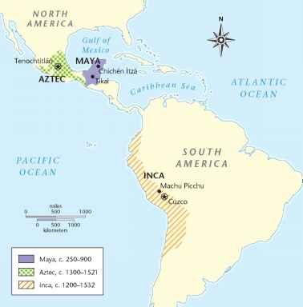
Map of Americas (Aztec, Inca and Mayans)

Slide 9
Maya Kings and Cities

Slide 10
If You were there….
You live in a village in the lowlands of Mesoamerica. Your family members have always been weavers, and now your aunts are teaching you to weave cloth from the cotton grown by nearby farmers. Traders from other areas often pass through your village. They tell wonderful stories about strange animals and sights they see in their travels. After talking to the traders who buy your cloth, you begin to think about becoming a trader, too.
Why Might you want to become a trader?

Slide 11
Maya Create City-States
The homeland of the Maya stretched from southern Mexico into northern Central America.
This area includes a highland region and a lowland region.
The lowlands lie to the north. They include the dry scrub forest of the Yucatán (YOO•kuh•TAN) Peninsula and the dense, steamy jungles of southeastern Mexico and northern Guatemala.
The highlands are further south—a range of cool, cloud-wreathed mountains that stretch from southern Mexico to El Salvador.

Slide 12
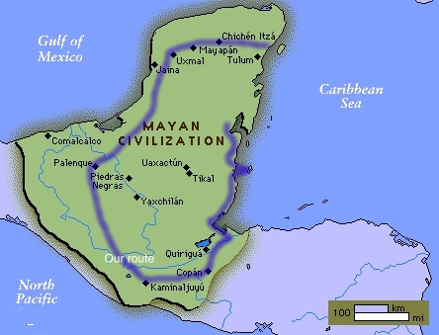
Map of Mayans

Slide 13
Geography Affects Early Maya
The Maya (MY-uh) civilization developed in Mesoamerica.
Early Maya lived in the lowlands of this region beginning around 1000 BC.
Thick forests covered most of the land, so the Maya had to clear wooded areas for farmland.
Like earlier Mesoamericans, the Maya grew maize and other crops.

Slide 14
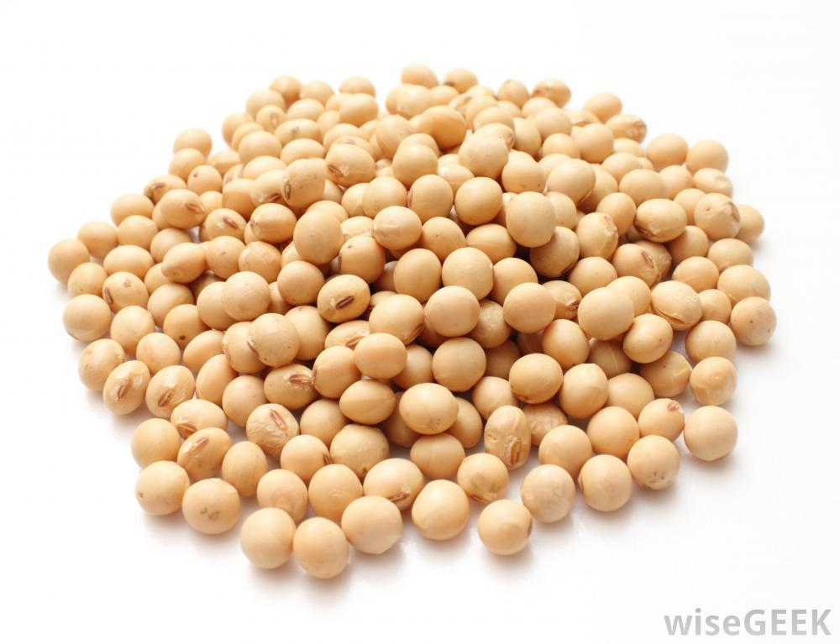
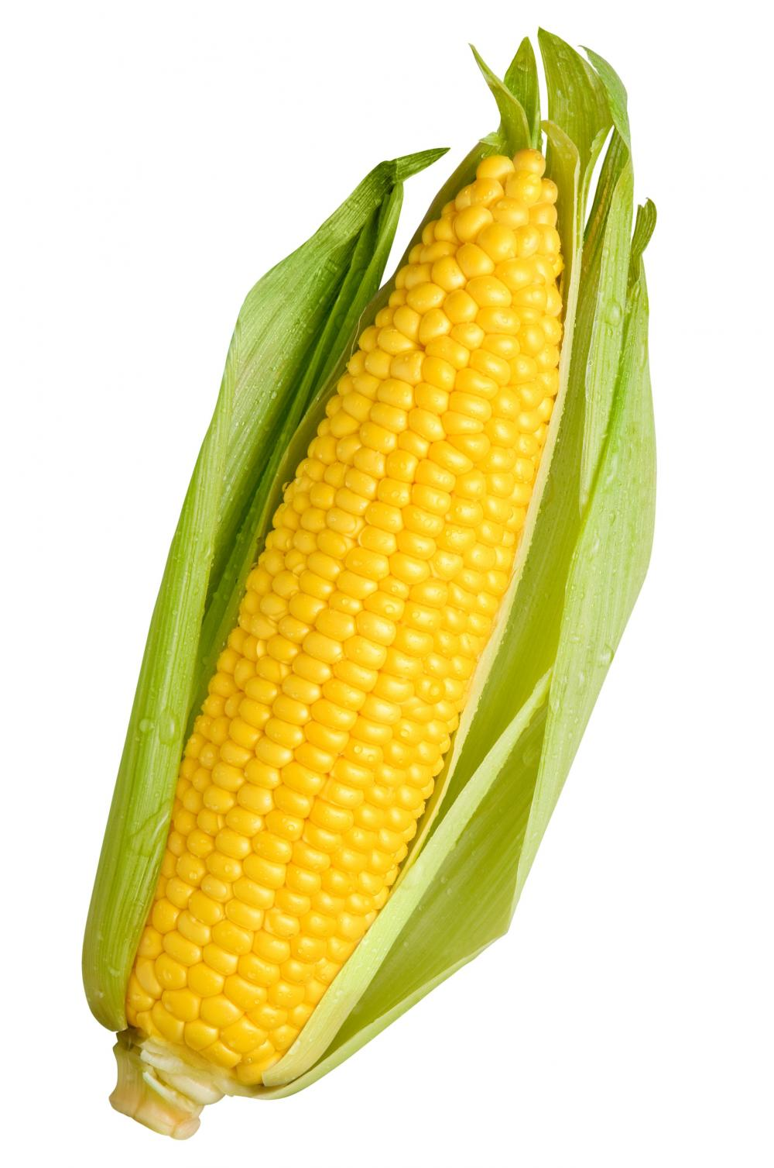
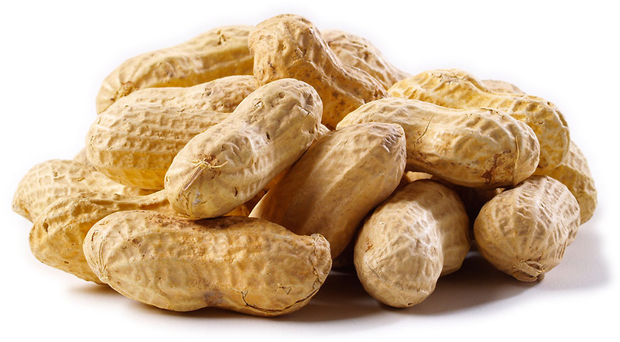
Guess: What is maize?
B
A
C

Slide 15
Geography Affects Early Maya
Although the thick forests made farming hard, they provided valuable resources.
Forest animals such as deer and monkeys were a source of food.
In addition, trees and other plants made good building materials.
For example, the Maya used wood poles and vines, along with mud, to build their houses.

Slide 16
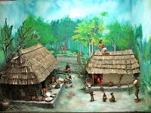

Slide 17
Geography Affects Early Maya
The early Maya lived in small villages. Eventually these villages started trading with one another.
They traded goods such as cloth and obsidian, a sharp, glasslike volcanic rock, that came from different parts of Mesoamerica.
As trade helped support larger populations, villages grew.
By about AD 200 the Maya were building large cities in the Americas.

Slide 18
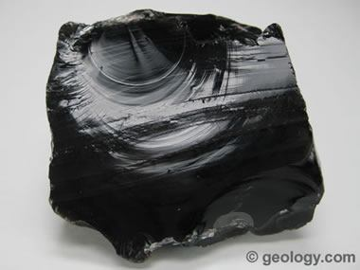

Slide 19
Maya Classic Age

Slide 20
Maya Classic Age
The Maya civilization reached its height between about AD 250 and 900.
Historians call this period of Maya history the Classic Age.
During the Classic Age, Maya civilization spread to the Yucatan Peninsula and grew to include more than 40 cities of 5,000 to 50,000 people each.

Slide 21
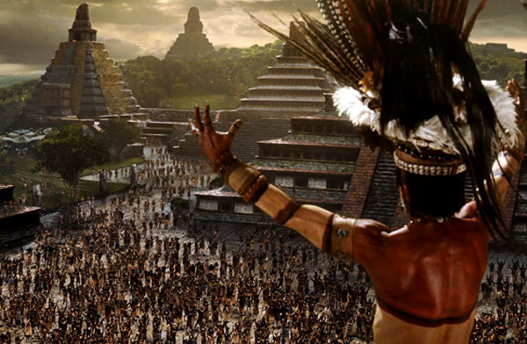

Slide 22
Trade
Maya cities in the highlands traded with those in the lowlands.
In this way people all over Maya territory got things that they didn't have nearby.

Slide 23
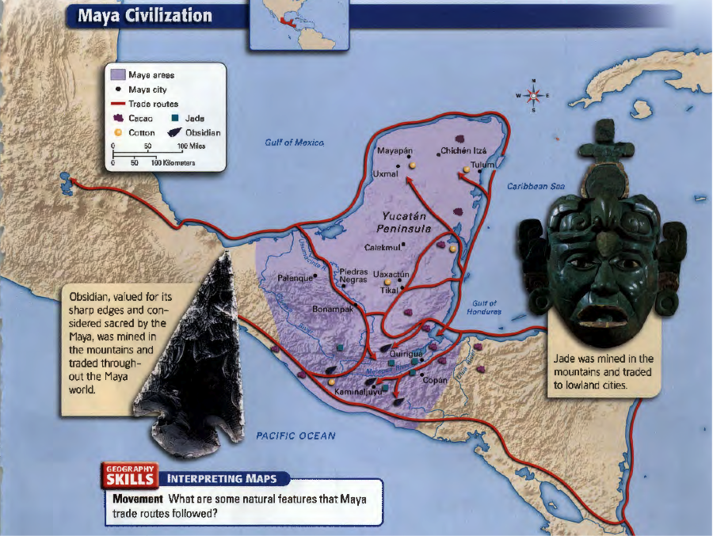

Slide 24
Trade
Look at the trade routes on the map to see the goods that were available in different areas of Mesoamerica.
For example, the warm lowlands were good for growing cotton, rubber trees, and cacao (kuh-KOW) beans, the source of chocolate.
Cacao beans had great value.
Chocolate was known as the food of rulers and of the gods.
The Maya even used cacao beans as money.

Slide 25
Trade
Lowland crops didn't grow well in the cool highlands.
Instead, the highlands had valuable stones such as jade and obsidian.
People carried these and other products along Maya trade routes.

Slide 26
City
Maya cities had many grand buildings, including large stone pyramids, temples, and palaces.
Some of these buildings honored local Maya kings.
For example, in the city of Palenque (pah-LENG-kay), a temple honored the king Pacal (puh-KAHL).
Pacal had the temple built to record his achievements as a ruler.
Maya artists decorated temples and palaces with carvings and colorful paintings.

Slide 27
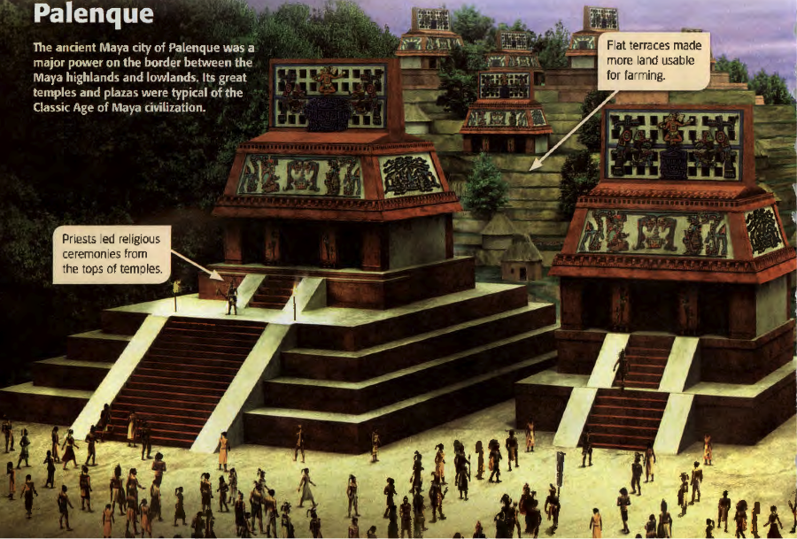

Slide 28
City
In addition to temples and palaces, the Maya also built structures to improve life in their cities.
For example, builders paved large plazas for public gatherings, and they built canals to control the flow of water through their cities.
Farmers shaped nearby hillsides into flat terraces so they could grow crops on them.

Slide 29
City
Most Maya cities also had a special ball court.
People played or watched a type of ball game in these large stone arenas.
Using only their heads, shoulders, or hips, players tried to bounce a heavy, hard rubber ball through a stone ring above their heads.
Players weren't allowed to use their hands or feet.
The winners were awarded jewels and clothing.
The losers were sometimes killed. This ball game was one that the Maya had picked up from Olmec traditions.

Slide 30
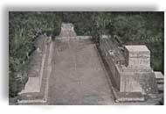

Slide 31
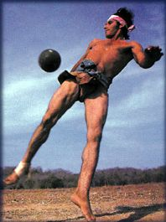
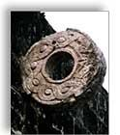
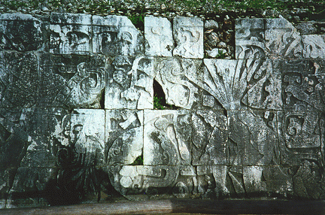
Decapitation scene at ball court

Slide 32
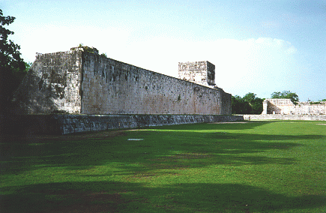

Slide 33
Homework
Find one aspect of Mayan civilization that you would like to research and write 1 page about it.
Include pictures and information.
Due: Feb 8, 2017

Slide 34
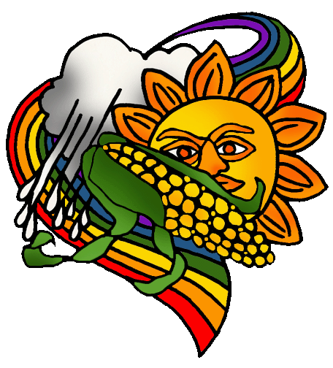

Slide 35
Society and Religion

Slide 36
Maya Religion
Kings had great influence in Maya society.
The Maya believed kings communicated with the gods.
The Maya worshipped many gods and believed they influenced daily life.
To prevent disasters and keep the gods happy, the Maya performed private and public rituals for the gods.

Slide 37
Maya Religion
One common ritual involved offering blood to the gods, usually by piercing the tongue or skin.
The Maya performed human sacrifice only on certain occasions.
Religious ceremonies were led by priests, who were part of the upper class.
Also part of the upper class were professional warriors.
They played an important role in Maya religion and society because they were responsible for getting war victims for use in human sacrifice.

Slide 38
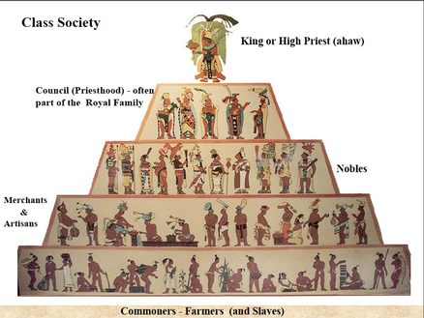

Slide 39
Maya Social Hierarchy
Religious ceremonies were led by priests, who were part of the upper class.
Also part of the upper class were professional warriors.
They played an important role in Maya religion and society because they were responsible for getting war victims for use in human sacrifice.

Slide 40
Maya Social Hierarchy
Just below the upper class in Maya society were merchants and skilled craftspeople.
Most men and women, however, were members of the lower class.
They were the farmers and slaves whose labor supported the wealthier classes.
They supported the upper classes by providing food and labor for public building projects.

Slide 41
Maya Social Hierarchy
Just below the upper class in Maya society were merchants and skilled craftspeople.
Most men and women, however, were members of the lower class.
They were the farmers and slaves whose labor supported the wealthier classes.
They supported the upper classes by providing food and labor for public building projects.

Slide 42
Achievements

Slide 43
Achievements
Impressive buildings and architecture, including canals, were a major achievement of the Maya.
In addition, the Maya made advances in astronomy, math, and writing.
They carefully observed the movements of the sun, moon, and planets.

Slide 44
Achievements
Based on what they observed, they created a calendar system.
The Maya had two calendars—a 365-day farming calendar and a 260-day religious calendar.
Priests consulted the calendars to determine what days would be lucky or unlucky for war, planting, and religious ceremonies.

Slide 45
Achievements
In spite of the way the Maya used their calendar system, it was more accurate than that used in Europe at the same time.
To go along with their calendars, the Maya created a number system that included some new concepts in math.
For example, the Maya were among the first people in the world to use the concept of zero.

Slide 46
Achievements
The Maya also developed a complex writing system to keep records.
Their writing consisted of glyphs, or symbols, that represented both objects and sounds.
The Maya carved their writing into large stone monuments called stelae.
They also kept written records in a type of bark-paper book later referred to as a codex.

Slide 47
Decline

Slide 48
Decline
A part of Maya history that is not clear from their written records is what caused their civilization to decline.
Scholars think that a number of factors caused the decline.
One factor may have been environmental damage from overuse of resources or a drought that made it difficult to feed everyone in the cities.

Slide 49
Decline
A related theory says that warfare increased over competition for land.
Increased warfare would have destroyed more crops.
A third factor in the decline could have been the abuse of power by particularly strong kings, such as Yax Pak of Copán.
The demands of kings could have caused people to rebel and leave their cities.

Slide 50
Decline
Although Maya civilization declined around 900, the Maya did not disappear.
Evidence suggests that the Maya from forest cities moved to new cities, such as Chichén Itzá in the Yucatán Peninsula.
Those cities remained powerful for several hundred years.
Eventually, however, the Maya abandoned those cities as well and scattered into small villages in the region.

