Slide 1
Jakarta Multicultural School IB Diploma Program

Slide 2
I think, therefore IB

Slide 3
Introduction to the International Baccalaureate
The International Baccalaureate Organization (IBO) is a nonprofit educational foundation established in 1968.
IB currently works with 2,650 schools (56% public) in 136 countries to develop and offer three challenging programs to over 560,000 students aged 3 to 19 years.
IB helps develop the intellectual, personal, emotional and social skills to live, learn and work in a rapidly globalizing world.

Slide 4
Organization: What is the IBO mission?
IBO is motivated by a mission to create a better world through education.
Mission:
“The International Baccalaureate Organization aims to develop inquiring, knowledgeable and caring young people who help to create a better and more peaceful world through intercultural understanding and respect.
To this end, the IBO works with schools, governments and international organizations to develop challenging programs of international education and rigorous assessment.
These programs encourage students across the world to become active, compassionate and lifelong learners who understand that other people, with their differences, can also be right.”

Slide 5
IB is Internationally-focused

Slide 6
Internationalism: what it means
From the IB perspective, internationalism is the development of responsible citizens of the world with young people who are active participants in their local and national communities, as well as in the broader international community.
Internationalism includes:
Genuine awareness of the interdependence of countries and peoples.
Ability to see one’s own culture, language and nation in a global perspective
Ability to recognize and rejoice in diversity

Slide 7
IB is student-centered

Slide 8
Student-centered: what it means
An IB teacher makes use of the knowledge and understanding that students bring with them to the classroom and aims to ignite a sense of wonder about learning and knowledge.
“Learning can only occur if students’ current understanding is challenged. It encourages teaching for understanding”
Tristian Stobie, Head of Diploma program development, IB
Focuses on the learner profile

Slide 9
The Learner Profile

Slide 10
What is the Learner Profile?
The Learner Profile is the IBO Mission Statement translated into a set of learning outcomes for the 21st Century
The Learner Profile promotes the education of the whole person, emphasizing intellectual, personal, emotional and social growth through all domains of knowledge.
The learner profile has to become part of the school culture to be effective.

Slide 11
They develop their natural curiosity. They acquire the skills necessary to conduct inquiry and research and show independence in learning. They actively enjoy learning and this love of learning will be sustained throughout their lives.
IB Learners strive to be:
Inquirers

Slide 12
They explore concepts, ideas and issues that have local and global significance. In so doing, they acquire in-depth knowledge and develop understanding across a broad and balanced range of disciplines.
IB Learners strive to be:
Knowledgeable

Slide 13
They exercise initiative in applying thinking skills critically and creatively to recognize and approach complex problems, and make reasoned, ethical decisions.
IB Learners strive to be:
Thinkers

Slide 14
IB Learners strive to be:
They understand and express ideas and information confidently and creatively in more than one language and in a variety of modes of communication. They work effectively and willingly in collaboration with others.
Communicators

Slide 15
They act with integrity and honesty, with a strong sense of fairness, justice and respect for the dignity of the individual, groups and communities. They take responsibility for their own actions and the consequences that accompany them.
IB Learners strive to be:
Principled

Slide 16
They understand and appreciate their own cultures and personal histories, and are open to the perspectives, values and traditions of other individuals and communities. They are accustomed to seeking and evaluating a range of points of view, and are willing to grow from the experience.
IB Learners strive to be:
Open-minded

Slide 17
They show empathy, compassion and respect towards the needs and feelings of others. They have a personal commitment to service, and act to make a positive difference to the lives of others and to the environment.
IB Learners strive to be:
Caring

Slide 18
They approach unfamiliar situations and uncertainty with courage and forethought, and have the independence of spirit to explore new roles, ideas and strategies. They are brave and articulate in defending their beliefs.
IB Learners strive to be:
Risk-takers

Slide 19
They give thoughtful consideration to their own learning and experience. They are able to assess and understand their strengths and limitations in order to support their learning and personal development.
IB Learners strive to be:
Reflective

Slide 20
They understand the importance of intellectual, physical and emotional balance to achieve personal well-being for themselves and others.
IB Learners strive to be:
Balanced

Slide 21
The IB Learner Profile in practice

Slide 22
Organization: What does the IBO offer?
The IBO develops three programs of international education for students aged 3 to 19, working in cooperation with IB World Schools.
The three programs span the years of kindergarten to pre-university. The programs can be offered individually or as a continuum.
The Primary Years program (PYP) for students aged 3 to 12.
The Middle Years program (MYP) for students aged 11 to 16.
The Diploma program (DP) for students aged 16 to 19.

Slide 23
Programs: What makes the DP unique?
A rigorous two year pre-university course that leads to examination.
Designed for students aged 16 to 19
Diploma students take six core subjects. Additionally, they write a 4,000 word extended essay, complete a course in theory of knowledge, and complete a number of creativity, action and service (CAS) projects.
The diploma is well recognized by approximately 2,200 of the world’s leading universities, the Ivy League schools, and over 1,200 other US universities.
Many IB schools teach the diploma program concurrently with the national curriculum, state standards, and/or AP
Supported in English, French and Spanish.
As well, non-Diploma track students may opt for certificates in particular subject areas

Slide 24
Programs: What makes the DP special?
More than a collection of facts.
Students are encouraged to:
ask challenging questions
learn how to learn
develop a strong sense of their own identity and culture
develop the ability to communicate with and understand people from other countries and cultures
become independent, self-motivated learners.

Slide 25
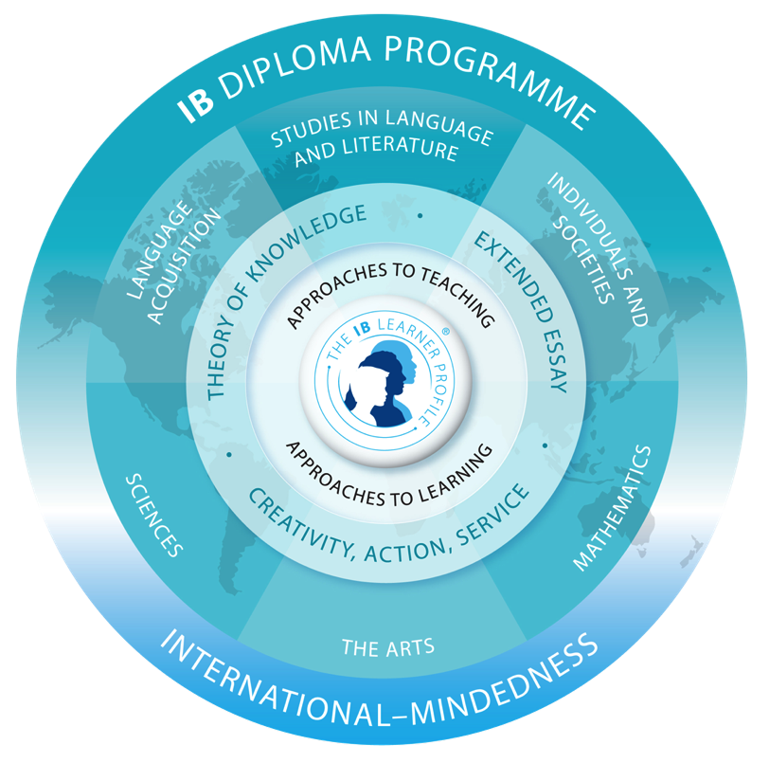
Curriculum: What does the DP curriculum contain? The curriculum contains six subject groups together with a core made up of three separate parts

Slide 26
Curriculum: What does the DP curriculum contain? The curriculum contains six subject groups together with a core made up of three separate parts
Three subjects are studied at higher level - 240 hours
Three subjects are studied at standard level - 150 hours
All three parts of the core—extended essay, theory of knowledge and creativity, action, service—are compulsory and are central to the philosophy of the Diploma program.

Slide 27
Curriculum: What does the DP curriculum contain? The curriculum contains six subject groups together with a core made up of three separate parts
GROUP 1 Language and Literature English HL/SL Language and Literature Bahasa Indonesian HL/SL | GROUP 2 Language B English HL/SL Spanish Ab Initio SL | GROUP 3 History HL/SL Geography HL/SL Business Management HL/SL
GROUP 4 Physics HL/SL Biology HL/SL Chemistry HL/SL | GROUP 5 Mathematics HL/SL Mathematics Studies SL | GROUP 6 No Arts Group offered at this time

Slide 28
Curriculum: What does the DP curriculum contain? The core requirements — Extended Essay (EE)
The extended essay:
has a prescribed limit of 4,000 words
offers the opportunity to investigate a topic of individual interest
familiarizes students with the independent research and writing skills expected at university
must include “…techniques appropriate to the discipline”
students select topic and work with volunteer instructors in topic area

Slide 29
Curriculum: What does the DP curriculum contain? The core requirements — Theory of Knowledge (TOK)
The interdisciplinary TOK course:
designed to provide coherence by:
exploring the nature of knowledge across disciplines
encouraging an appreciation of other cultural perspectives
Part I – focus on limitations of humans as knowers – perceptions, emotions, languages, reason
Part II – development of skills to evaluate knowledge claims in the various disciplines.

Slide 30
Curriculum: What does the DP curriculum contain? The core requirements — Creativity, Activity, Service (CAS)
Participation in the school’s CAS program:
encourages students to be involved in artistic pursuits, sports and community service work - 50 hours each
fosters students’ awareness and appreciation of life outside the academic arena
the hours are designed to be on-going; spanning the duration of the Diploma program

Slide 31
Earning the IB Diploma
Performance in each IB subject is graded on a scale of 1 to 7 points. A maximum of 3 additional points is awarded for combined performance in the two additional Diploma Programme requirements: Theory of Knowledge and Extended essay.
Maximum total possible DP scores is 45.
The minimum is at least 24 points to earn a diploma.

Slide 32
Earning the IB Diploma

Slide 33
Academic Program: JMS High School
Full IB Diploma Pathways | Combination Pathways (IB Certificates and JMS Diploma) | Full JMS Diploma
6 IB Courses from 5 groups (3 Standard Level + 3 High Level) | 1-5 IB Certificate Courses + the classes not IB will be part of JMS Curriculum | All classes are only counted towards JMS transcript and diploma
Extended Essay | Extended Report (Smaller than the extended essay graded internally) | Extended Report (Smaller than the extended essay graded internally)
Theory of Knowledge Course | Theory of Knowledge Course | Theory of Knowledge Course
Creativity, Activity, Service (CAS) | Creativity, Activity, Service (CAS) (Graded Internally) | Creativity, Activity, Service (CAS) (Graded Internally)
Required Subjects | Required Subjects | Required Subjects

Slide 34
What should I Choose?
The decision to choose IB Full Diploma, IB Certificates and / or JMS Diploma will be based on discussion between student, parents and the school.
All students will be watched closely to make sure the stress isn’t too much on them.
Final decision for a student to sit for exams and to take IB is at the decision of the DP Coordinator
Students will have to go through National Exams. (of course this be updated as the law progresses on this)
Full Diploma Program and Certificate will have to go through each DP subject external examination
There will be extra cost for each DP subject examination (end of year 12 which will be May exanimations)

Slide 35
Required Subjects
Religion (According to students faith) | Due to government requirement this will be required once a week.
Indonesian Studies / Civics Studies | 1 Semester will be Indonesian Studies and 1 Semester will be Civics Studies
Music / Visual Art | This course offers the students for students to explore their talents outside of just academic. Once a week.
Physical Education | This course offers activities to promote team work and cooperation; motor skill development; physical fitness; knowledge of rules and strategies of game play; and an appreciation of the importance of exercise for a healthy lifestyle.

Slide 36
When will subject selection occur?
There will be a 3 way conference at the beginning of Term 4.
This conference will be with parent, student and DP Coordinator.
This is to make sure everyone has a clear understanding.
Now as we all know teenagers do change their minds. So the choices are not in Stone but can be changed up to the first week of Semester 1 year 11.
Now if during this sign up only 2 students sign up for Physics. Depending on the needs of the students university the class will be closed and won’t be an option to change to later on in the year.

Slide 37
Visit to Sampoerna University will be on March 6th, 2017

Slide 38
Questions?

Slide 39
If you have any questions please feel free to contact me at: corey.allison@jimsch.org

