Slide 1
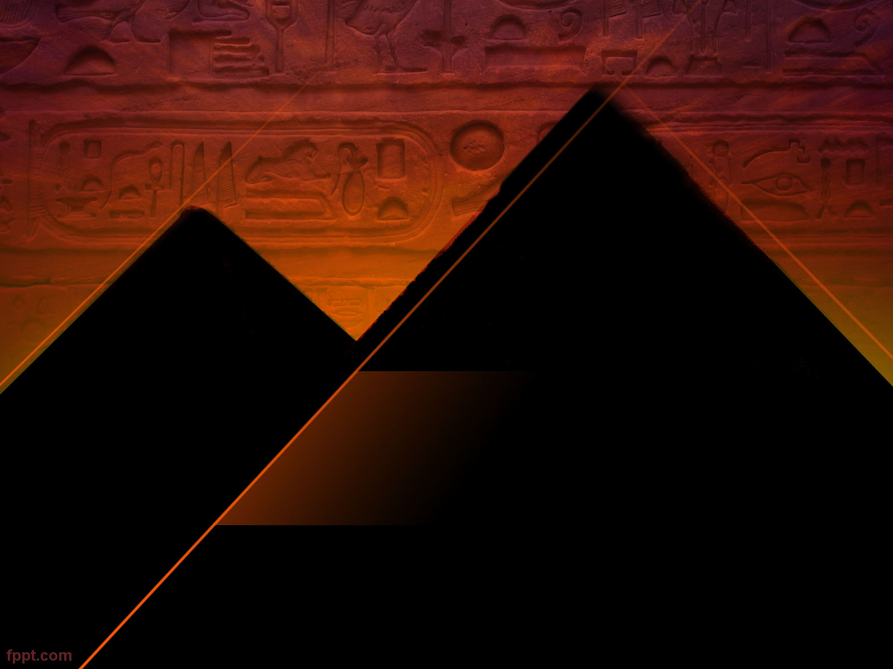
Nile Civilizations
5000 BC – AD 300

Slide 2
The Big Picture
The Nile is the longest river in the world. In addition to this geographic distinction, it is also known as the site of one of the world’s earliest civilizations—ancient Egypt.
Egypt, the land of pyramids and pharaohs, is certainly the most famous civilization of the Nile, but it was not the only one.
South of Egypt, in the region called Nubia, other civilizations grew and made great cultural advances of their own.

Slide 3
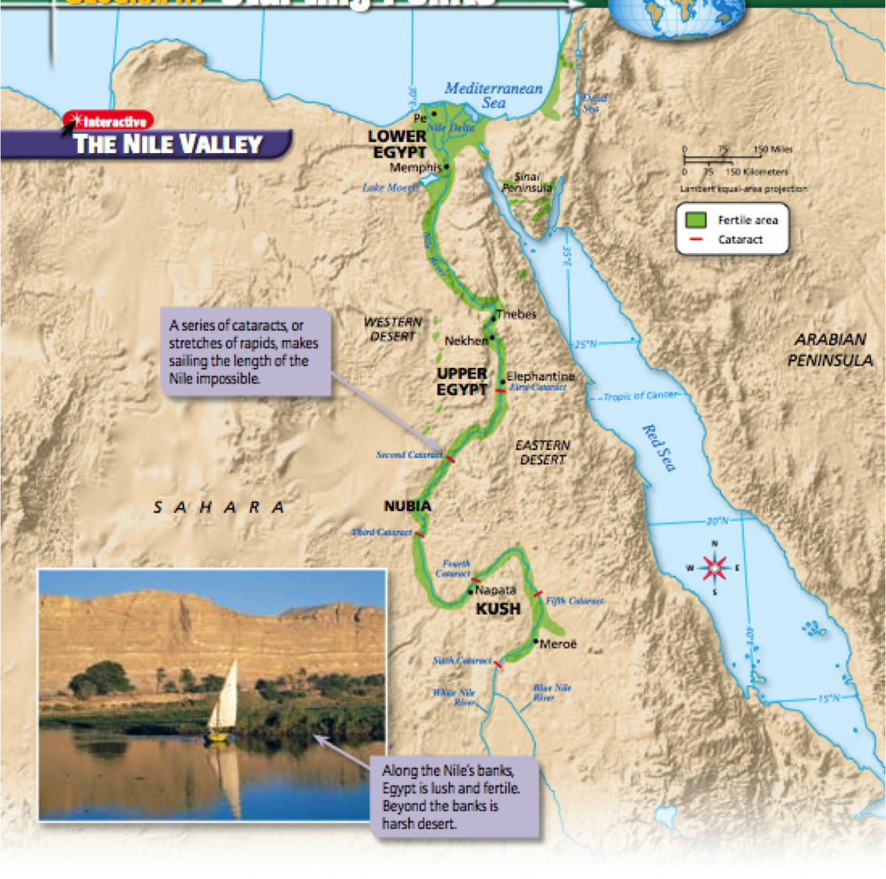
The Big Picture

Slide 4
Starting Point
The Nile, the longest river in the world, flows northward from eastern Africa to the Mediterranean.
Over much of its course, the Nile flows through the Sahara, the largest desert in the world and one of the harshest.
The civilizations that developed along the Nile depended on the river to irrigate their lands and to make life possible.

Slide 5
Predict
Look at the area labeled as fertile on the map. Based on this information, where do you think civilizations developed?
Egypt is isolated from other regions by the desert and by cataracts on the Nile. How might this isolation have affected early Egyptian society?

Slide 6
The Kingdom of Egypt
Key Terms and People
  Delta
  Cataracts
  Menes
  Pharaoh
  Theocracy
  Bureaucracy
  Hatshepsut
  Ramses the Great

Slide 7
The Gift of the Nile

Slide 8
What was the gift of the Nile?
Sometime in the 400s BC, a Greek historian named Herodotus traveled to Egypt. Like many people in Greece, he had heard of Egypt but knew very little of life there. What he saw on his journey both impressed and amazed him.
Of all the sights Herodotus witnessed in Egypt, none left more of an impression on him than the Nile itself. For a Greek who took rain for granted, it was unthinkable that a society could depend on a river for all of its water. He was astounded at stories of the annual floods that brought water to the fields. These floods, he thought, made the work of Egyptian farmers incredibly easy. In contrast, the Egyptians to whom Herodotus spoke listened in disbelief to his descriptions of rain. They did not seem to trust the idea of water that did not come from a river.

Slide 9
What was the gift of the Nile?
Herodotus also could not believe the variety of animals that dwelled in or near the Nile, from fish and birds to crocodiles and hippopotamuses. Without the Nile, Herodotus concluded, Egypt could not exist: “For any one who sees Egypt, without having heard a word about it before, must perceive, if he has only common powers of observation, that the Egypt to which the Greeks go in their ships is an acquired country, the
gift of the river.“

Slide 10
Geography and Early Egypt
As Herodotus noted, the Nile is the most important physical feature in Egypt.
The river, the longest in the world, flows more than 4,000 miles through north Africa.
For much of this length, the river flows through the Sahara, the world’s largest desert.
Without the Nile’s waters, no one could live there.

Slide 11
The Geography of Egypt
Like the Tigris and Euphrates in Mesopotamia, the Nile flooded every year.
Unlike floods on the Mesopotamian rivers, however, the Nile’s floods were predictable.
These floods occurred every year when spring rains fed the river’s sources south of Egypt.

Slide 12
The Geography of Egypt
The floodwaters that poured over the river’s banks covered the surrounding land with a rich black silt.
Because of these floods, a narrow band of fertile soil stretched all along the Nile.
It was in this band that Egyptian civilization developed.

Slide 13
The Geography of Egypt
The richest and most fertile soils in all Egypt were found in the Nile Delta.
A delta is an area at the mouth of a river, often triangle- shaped, made up of silt deposits.
Because the Nile is so long and carries so much silt, its delta is one of the largest in the world.

Slide 14
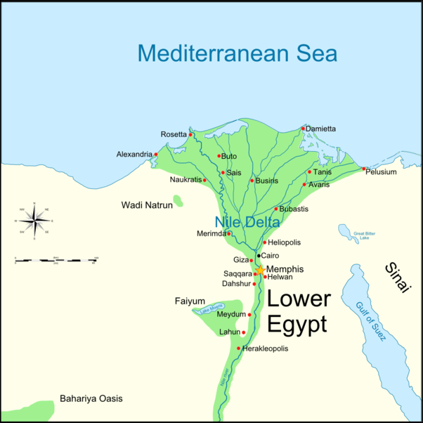
The Geography of Egypt

Slide 15
The Geography of Egypt
The dark color of the Nile river silt gave rise to the Egyptians’ name for their country—the Black Land.
In contrast, they called the surrounding desert the Red Land.
Although the desert was mostly unlivable wasteland, its presence was something of a comfort to the Egyptians.
The Sahara was so difficult to cross that it discouraged peoples from invading.

Slide 16
Two Kingdoms
The first farming villages along the Nile appeared as early as 5000 BC.
Over time, these villages consolidated into two kingdoms.
The people of these kingdoms spoke different dialects, or versions of the same language, and had different customs.

Slide 17
Two Kingdoms
The northern kingdom, Lower Egypt, was located downriver at the lower end of the Nile.
It occupied most of the Nile Delta, where the climate was milder than it was in the south.
The people of Lower Egypt worshipped a cobra goddess, and as a result that snake was a symbol of their kingdom.

Slide 18
Two Kingdoms
South of Lower Egypt was Upper Egypt, which lay along the river’s upper stretches.
It stretched from south of the delta to about the first cataract.
Upper Egyptians prayed to a vulture goddess, so a vulture was their symbol.

Slide 20
Unification
The two kingdoms of Egypt were first unified around 3100 BC.
Historians are not sure exactly how the unification came about, but ancient Egyptian legends say that a ruler named Menes (mee-neez) from Upper Egypt conquered the north.
Menes is also said to have founded the city of Memphis, the capital of unified Egypt.

Slide 21
Unification
As the ruler of both kingdoms, Menes adopted the symbols of both Upper and Lower Egypt, the cobra and the vulture.
He also wore a crown that combined the traditional red and white crowns of the two kingdoms.
Later Egyptian rulers likewise used both sets of symbols to show their power over all Egypt.

Slide 22
Unification
Menes founded Egypt’s first dynasty, or series of rulers from the same family.
Through its long history, Egypt was ruled by a string of dynasties.
Historians use these dynasties as a tool for organizing their studies of Egyptian history.
For example, they may refer to rulers of the Seventh dynasty or events that occurred during the Twenty-second dynasty.
In total, 31 dynasties held power in Egypt.

Slide 23
The Old Kingdom

Slide 24
The Old Kingdom
The rise of the Third dynasty in about 2650 BC marked the beginning of a long period of stable rule in Egypt.
This period, known as the Old Kingdom, lasted about 500 years.
Egyptians of the Old Kingdom created many of the institutions for which the civilization is best known.

Slide 25
The Pyramids
The most famous symbols of ancient Egypt are the pyramids.
Most of these huge structures were built during the Old Kingdom.
The largest and most famous of the Old Kingdom pyramids are located near the town of Giza.

Slide 26
The Pyramids
The pyramids were built as tombs for Egypt’s rulers.
Inside or below each pyramid was a hollow chamber in which a dead king was buried.
To protect the bodies of their kings and the treasures that were buried with them, the Egyptians sometimes placed deadly traps within a pyramid.

Slide 27
The Pyramids
Pyramid design changed greatly over time.
The earliest pyramids did not have smooth sides.
Instead, their sides looked like a series of steps.
The smooth-sided pyramids with which we are familiar were built later.

Slide 28
The Pyramids
However they changed, building pyramids took a great deal of planning and skill—and time.
In fact, pyramids took so long to construct that kings usually ordered their pyramids begun soon after they took the throne.
Workers built the pyramids from the inside out, carefully placing limestone blocks cut from nearby quarries.

Slide 29
The Pyramids
These blocks had to be dragged overland to the building site on rollers.
Historians are not certain how workers hauled the heavy stone blocks up the sides of the pyramid, but some think that workers dragged the blocks up specially built ramps with ropes.

Slide 30
The Pyramids
Despite what many people believe, the pyramids were not built by slaves.
Most of the workers were peasants who were required to work for the government for one month out of the year.
While they worked on a pyramid, the peasants received food and clothing and were sheltered in nearby villages.

Slide 31
The Pyramids
Not all of the workers on a pyramid were peasants, though.
Professional craftspeople were also hired to work on the tombs.
Among them were the architects who actually designed the pyramid and surrounding buildings and the artists hired to decorate the interior of the finished tomb.

Slide 32
The Pyramids

Slide 33
The Pyramid Activity

Slide 34
The Pyramids

Slide 35
The Pharaohs

Slide 36
The Pharaohs
Egypt’s government also took shape during the Old Kingdom.
At the head of the government was the king, who eventually became known as the pharaoh (fer-oh).
The term pharaoh literally means “great house.” Pharaohs had absolute power in Egypt.
They owned all the land in the country, and their word was law. In addition, pharaohs acted as judges and as the leaders of Egypt’s army.

Slide 37
The Pharaohs
One reason for the pharaoh’s great power was the belief that he was a god.
The ancient Egyptians believed that the pharaoh was really a god in human form.
As such, people thought that the pharaoh was responsible for Egypt’s prosperity.
He and his priests had to perform elaborate rituals every day to ensure that the sun would rise, the Nile would flood, and crops would grow.

Slide 38
The Pharaohs
For his role in keeping Egypt safe and secure, people honored the pharaoh:
“Adore the king . . . living forever, in your innermost parts. Place His Majesty in friendly fashion in your thoughts . . . He is Re [the sun], by whose rays one sees, for he is one who illumines the Two Lands [Upper and Lower Egypt] more than the sun disk. He is one who makes [the land] green.”
—Loyalty instructions from the Sehetepibre Stela

Slide 39
The Pharaohs
Because the pharaoh was thought to be a god, religion and government were closely intertwined in the Old Kingdom.
Egypt was a theocracy, a state ruled by religious figures.

Slide 40
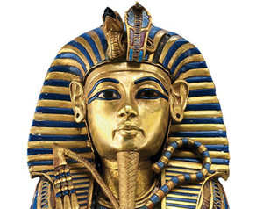
The Pharaohs

Slide 41
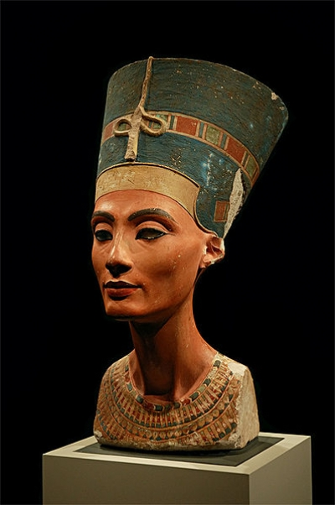
The Pharaohs

Slide 42
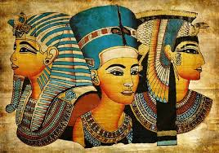
The Pharaohs

Slide 43

The Pharaohs

Slide 44
Vocabulary on test
Prehistory
Ancestor
Hominid
Domestication
Neolithic Era
Agriculture
Paleolithic Era
Tool
Hunter-gatherers
Develop
Land Bridge
Migrate
Society
Megaliths
Neolithic Era
Delta
Pharaoh
Theocracy

