Slide 1
Nile Civilizations
5000 BC – AD 300

Slide 2
Creating a Timeline
Group Activities

Slide 3
Group Activity
Activity 1: Research
In groups 3-4, you will research one of the following periods: Old Kingdom, Frist Intermediate period, Middle Kingdom, Second Intermediate Period, Early New Kingdom and Late Period
Create a Presentation (5 minute presentation max and 2 half minutes min)
Create a Timeline for the time period assigned to your group.
(You will be given Monday and Tuesday to work on them)
After your presentation is complete and timeline is finished you need to create 3-5 questions on the major points of your research and presentation.
Presentations will take place on Friday

Slide 4
Guiding Questions
The Questions provided are just here to help you complete your research and presentation. You are welcome to also create your ideas for your presentation.
The years spanned in the period assigned to you.
What are some major events during the time period?
What kind of major advances / discoveries?
Who was the leader (s) during this time period?
What wars/battles occurred during this time period? Was they significant to the change of the kingdom or period.
What else do you think is important or interesting you would like to share with the class.

Slide 5
Group Activity
Aiden – Omid – Late Period
Keila – Selma – Second Intermediate Period
Abigail – Syafina – Jasmin – Middle Kingdom
Hanz – Mazel Gabriel– First Intermediate Period
Raafi – Kenzie –– Early New Kingdom

Slide 6
KWL Chart
Now we will take a look at the poster on the side of the class.
Each of you will be given 3 pieces of paper:
Each of you will have a choice to write 2 pieces of paper for K (What do you know?) and one for W (What do you want to find out?). Or you can do 1 piece of paper for K and two for W. It is your CHOICE!
Everyday at the end of the lesson you will fill in a piece of paper for L (What did you learn?)

Slide 7
Discussion
What does social roles mean?
Do we have social roles in our society today?

Slide 8
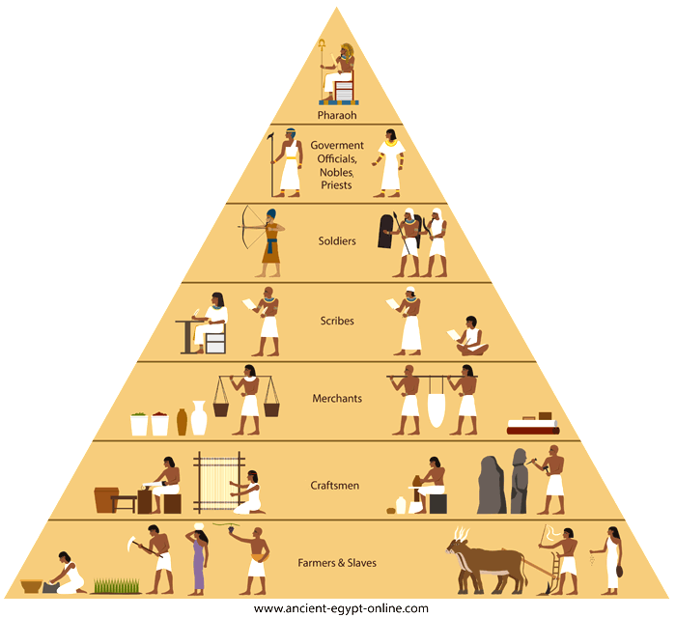
Ancient Egypt Social Hierarchy Pyramid

Slide 9
Ancient Egypt – Social Hierarchy
Egyptian society was highly stratified, or layered. At the very top of society, of course, was the pharaoh and the royal family.
Also prominent and influential in Egypt were key government officials, priests and priestesses, scribes, military leaders, landowners, and doctors.
These people were all among the wealthiest in Egypt.

Slide 10
Ancient Egypt – Social Hierarchy
The next level of society included artisans, craftspeople, and merchants.
These were the people who made and sold the goods, such as jewelry and clothing, used by others both in Egypt and in other lands.
The largest part of Egyptian society, about 90 percent of the population, was made up of peasant farmers.
Although they spent most of their time in the fields, these farmers could also be recruited to build large public works, such as the pyramids, during the flood season.
Farmers were also sometimes asked to work in quarries or mines or to serve in the army.

Slide 11
Ancient Egypt – Social Hierarchy
The Egyptians kept slaves, but slaves never made up a large part of the kingdom’s population.
Most slaves were convicted criminals or prisoners of war.
They worked on public projects, in private households, or in temples.
The number of slaves in Egypt increased during the later New Kingdom.

Slide 12
Ancient Egypt – Social Hierarchy
In some ways, Egyptian society was less rigid than other ancient civilizations.
Although sons usually learned the same jobs their fathers had, it was possible though rare for people to become educated, to find better jobs, and to gain social status.
Perhaps the fastest way to gain status was to become a scribe.
Scribes’ ability to write made them highly sought after.
Scribes composed and copied religious texts, collected taxes, and kept public records.

