Slide 1
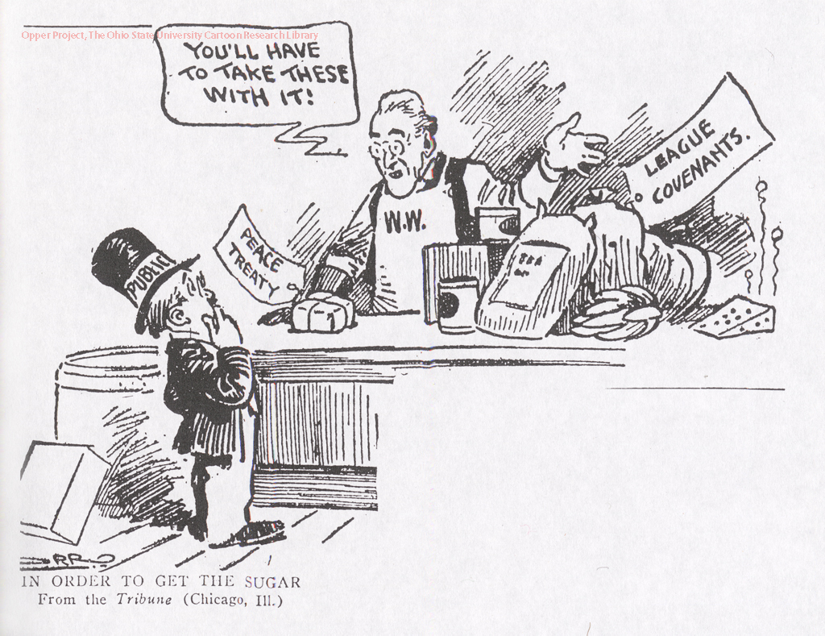
IGCSE History Revision 1. Were the peace treaties of 1919-23 fair?

Slide 2
Revision Tips
Make sure you know why the “Big Three” held the positions they did with regard to Germany. You will find the differences between the “Big Three” reflected their different wartime experiences and defensive positions.
You will need to be familiar with Wilson’s Fourteen points (check pdf on website) and the reasons Lloyd George’s views changed after November 1918.

Slide 3
Revision Tips
The terms of the Treaty of Versailles have to be learnt.
You will also need to be able to identify which terms pleased or displeased each of the “Big Three.

Slide 4
Revision Tips
You will need to be able to explain the various reason why Germany objected to the Versailles.
You should also cover the terms that each of the minor treaties had in common, together with an understanding of how Czechoslovakia and Yugoslavia were formed out of the territory of the former Austro-Hungarian Empire.

Slide 5
Treaty of Versailles Overview

Slide 6
Overview
Treaty of Versailles signed by Germany, 28th June 1919: took away 13% land, 12.5% population, 16% coalfields, nearly 50% iron and steel industry, 3⁄4 iron ore.
Terms of Treaty of Versailles:
GARGLE
Guilt
Arms Restrictions
Reparations
German Territory
League of Nations

Slide 7
GARGLE
Guilt: Article 231 appointed blame, called ‘diktat’.
Arms restrictions: Army (100,000 soldiers), Navy (6 battleships, 15,000 sailors & no submarines), Air force forbidden, demilitarized Rhineland, conscription ban
Reparations: 6.6 billion pounds,

Slide 8
GARGLE
German Territory: Alsace Lorraine to France, Danzig to Poland, West Prussia & Posen form Polish corridor, East Prussia separated from rest of Germany, Colonies: Togoland, Cameroon, German South West Africa, and German East Africa given to victors.
LE: League of the Nations established.

Slide 9
Treaty of St. Germaine with Austria, 1919
Established Anschluss ban
Imposed reparations
Reduced army to 30,000 men
Ended dual monarchy
Gave Galicia to Poland, Bohemia & Moravia to Czechoslovakia & Bosnia & Herzegovina to Yugoslavia
Severe economic problems as a result as industrial land gone to Czechoslovakia
Displacement of people

Slide 10
Treaty of Trianon with Hungary, 1920
Induced economics crisis in Hungary
Transylvania to Romania, Slovakia & Ruthenia to Czechoslovakia; Slovenia, Croatia to Yugoslavia
3 million Hungarians displaced

Slide 11
Treaty of Neuilly with Bulgaria, 1919
Because it was a minor player in the war, gained territory from Turkey.
Reduced army to 20,000 men armed force, 100 million pound reparations, lost lands to Greece, Romania, Yugoslavia, access to Mediterranean Sea.

Slide 12
Treaty of Sevres with Ottoman Empire, 1920
Negation on territorial terms led by Mustafa Kemal which led to war between Greeks and Turks - unsuccessful treaty
The Arabs were promised Arab state for siding with Britain & France to defeat Germany, Palestine problem till date.

Slide 13
Treaty of Lausanne with Ottoman Empire, 1923
Gave disputed region of Smyrna back to Turkey after Young Turk revolution

Slide 14
The Outcome
Czechoslovakia (carved out of old Austrian empire and Germany - Bosnia and Herzegovina, Bohemia, and Moravia)
Yugoslavia (Kingdom of Serbs, Croats & Slovenes then named ‘land of the South Slavs’)
Poland renewed, via Danzig granted access to the sea, they wanted it to be a watchdog on Germany, buffer against communism, although 30% not ethnically Polish so some demographic problems, unfair amount of territory taken from Russia immediately led to war with Russia in 1921

Slide 15
The Outcome
Syria and Lebanon=French Mandate; Palestine, Transjordan & Iraq=British Mandate. Article 119 TOV: All Germany’s colonies taken and given to France and Britain as ‘mandates’.

Slide 16
Why was (any of three leaders) dissatisfied with TOV? - Clemenceau
French Prime Minister Georges Clemenceau was a realist, wanted punitive peace and compensation, aimed to weaken Germany as much as possible and blame them alone, wanted reparations (compensations for infrastructural damage - France been invaded twice since 1870), wanted military restrictions and Germany broken into smaller confederations + independent Rhineland + permanent control of Saarland.

Slide 17
Why was (any of three leaders) dissatisfied with TOV? - Wilson
American President Woodrow Wilson was an idealist, wanted to punish Germany but not too harshly, worried about spread of communism if too weak and revenge from Germans, wanted to strengthen democracy based on ’14 points’ = disarmament, League of Nations, self- determination.

Slide 18
Why was (any of three leaders) dissatisfied with TOV? - Wilson
He wanted to build more peaceful world but there were problems with some of the main ideas:
Problems with self-determination: people of Eastern Europe scattered across many countries e.g.: 25% of the people who lived in Czechoslovakia were not Czechs or Slovaks. 30% of Poland not Polish. 3 million Hungarians being ruled by foreigners.
Some people were bound to end up being ruled by another group with different customs and language because borders were artificially imposed.

Slide 19
Why was (any of three leaders) dissatisfied with TOV? - Wilson
Problems with LON: ‘ toothless’ without military, structurally insufficient & confusing, unanimous vote required, ’mandates’ seen as colonialist, membership problems: US, Germany, USSR absent, org seemed euro- centric and imperialist, supported TOV = seen as unfair

Slide 20
Why was (any of three leaders) dissatisfied with TOV? - George
British Prime Minister Lloyd George was a mediator, wanted a punitive but just peace, wanted Germany to lose colonies and navy as they threatened hegemony of British Empire but did not want Germany to seek revenge under pressure to ‘make Germany pay’, wanted to recover as trade partners as it created British jobs.

Slide 21
Why did all the victors not get everything they wanted?
They all made compromises:
Clemenceau wanted harsh peace a broken-up Germany and an independent Rhineland and disarmed German along with compensation.
He got limited compensation and military restrictions, a unified Germany and demilitarized Rhineland.
He felt this was not harsh enough and didn’t get independent Rhineland or control of Saarland.

Slide 22
Why did all the victors not get everything they wanted?
Clemenceau felt that Britain was happy to treat Germany fairly in Europe which threatened France yet were less happy to treat them fairly when it came to concessions of colonies and military which threatened Britain.

Slide 23
Why did all the victors not get everything they wanted?
Wilson wanted a just peace based on 14 points: he did not want Germany blamed (article 231 & reparations) in TOV but they were.
He successfully established self-determination in Eastern Europe and League of the Nations.
Demilitarization was not achieved except by force in Germany and TOV/LON ultimately not ratified.

Slide 24
Why did all the victors not get everything they wanted?
Britain wanted a compromise peace; was happy that German armed and naval forces were restricted, Lloyd received hero’s welcome, although the spread of communism still worrying him.

Slide 25
Why did all the victors not get everything they wanted?
There were disagreements over self-determination & ‘access to sea’ clause, the harshness of the treaty and LON (Wilson wanted world parliament, Lloyd wanted to get together in emergencies only.) Clemenceau resented Wilson’s generosity, wanted strong League with army.

Slide 26
The reasons Lloyd George’s views changed after November 1918
First there are many possible reasons for Lloyd George’s change in views. I have provided several sources that has good points of view on why his views have changed.

Slide 27
Source 1
http://www.historylearningsite.co.uk/

Slide 28
The reasons Lloyd George’s views changed after November 1918
David Lloyd-George the British Prime Minister was in a difficult position. Britain had suffered huge casualties in the war and the general public was demanding revenge. Typical headlines in British newspapers such as 'Make Germany Pay' and 'Hang the Kaiser' reflect public feeling. Lloyd-George was determined to maintain Britain's naval supremacy and to enlarge the British Empire. He had also announced in the 1918 election campaign that he expected Germany to pay as much as she could for the damage she had caused. Lloyd George was also prepared to see Germany's military strength reduced.

Slide 29
The reasons Lloyd George’s views changed after November 1918
On the other hand he was also aware that the new Weimar leaders of Germany were different to those of the Kaiser's time and that an over harsh treaty might undermine them and create an embittered Germany. He was also concerned that if the peace treaty humiliated Germany it might provoke a Bolshevik revolution. Whilst he was prepared to talk in harsh terms for the people home in the UK, Lloyd-George worked to ease some of the harsher terms wanted by Clemenceau.

Slide 30
Source 2
http://www.historylearningsite.co.uk/

Slide 31
The reasons Lloyd George’s views changed after November 1918
David Lloyd George of Great Britain had two views on how Germany should be treated.
His public image was simple. He was a politician and politicians needed the support of the public to succeed in elections. If he had come across as being soft on Germany, he would have been speedily voted out of office. The British public was after revenge and Lloyd George's public image reflected this mood. "Hang the Kaiser" and "Make Germany Pay" were two very common calls in the era immediately after the end of the war and Lloyd George, looking for public support, echoed these views.

Slide 32
The reasons Lloyd George’s views changed after November 1918
However, in private Lloyd George was also very concerned with the rise of communism in Russia and he feared that it might spread to western Europe. After the war had finished, Lloyd George believed that the spread of communism posed a far greater threat to the world than a defeated Germany. Privately, he felt that Germany should be treated in such a way that left her as a barrier to resist the expected spread of communism. He did not want the people of Germany to become so disillusioned with their government that they turned to communism. Lloyd George did not want Germany treated with lenience but he knew that Germany would be the only country in central Europe that could stop the spread of communism if it burst over the frontiers of Russia. Germany had to be punished but not to the extent that it left her destitute. However, it would have been political suicide to have gone public with these views.

Slide 33
Source 3
PenglaisSchool, Aberystwyth, History site

Slide 34
The reasons Lloyd George’s views changed after November 1918
Lloyd George was anxious to preserve Britain’s naval supremacy and was prepared to enlarge the British Empire (under Conservative pressure). He was all too aware of the strong anti-German feeling in Britain and in the 1918 election campaign he announced that he expected Germany to pay ‘to the limit of her capacity’. He was prepared to destroy German militarism but he distinguished between the old imperial German leaders and the German people as a whole. He felt that it would be unwise to persecute the new parliamentary leaders for the sins of the Kaiser. Lloyd George was inclined towards leniency since he felt that to leave an embittered Germany would be to store up problems for the future, as the Germans would wish to exact retribution. Lloyd George also feared the possibility of an excessively humiliated Germany being drawn into the arms of the Bolsheviks.

Slide 35
Source 4:
from a review by Joel Blatt, University of Connecticut, for H-France Book Reviews (April 2001)
of The Legacy of the Great War: Peacemaking, 1919, ed. William R. Keylor (1998)

Slide 36
The reasons Lloyd George’s views changed after November 1918
Wilson appealed for a peace of “justice, not vengeance”. In the "Fontainebleau Memorandum," David Lloyd George also called for a moderate peace. Having advocated a tough treaty during the election campaign of December 1918, and after achieving a number of his goals, the British Prime Minister changed direction. He worried that a severe peace could destabilize German politics and spread “Communism from Russia to the Rhine”. He pressed for a peace the Germans could accept. The British Prime Minister also requested Clemenceau’s territorial restraint. He said: “Germany will remain, despite everything, and it would be folly to believe that we can reconstruct the world without her assistance”

Slide 37
What was the impact of peace treaties on Germany up to 1923?

Slide 38
Reactions
Horror & outrage, war guilt clause was particularly hated
Betrayed, blamed ‘November Criminals’, Jews, Communists, Germans did not feel that they had lost the war as most of war went well for Germany.
Angry because government not represented at Versailles conference (diktat).
German army limited but disarmament not practiced by other countries.
Reparations pushed country deeper into state of near- starvation, feared it would cripple economy
Colonies taken double standards for self-determination: Germans displaced, not allowed to rule themselves

Slide 39
Impact
New government had many enemies: Communists, Nationalists, Army Internal scapegoats - Jews, Communists, November Criminals (‘Stab in back theory’)
Political violence- Spartacists 1919, Kapp Putsch 1920, Munich Putsch, Ruhr Invasion 1923 (French killed 100 German workers and expelled 100,000)
Economic problems &eventually, hyperinflation
Rise of Hitler- Hitler used unpopularity of TOV to his advantage by luring people to nationalist ideas of restoring homeland’s former glory

Slide 40
Was it fair?
No: Too harsh, blamed the wrong people as Germany had a new democratic government (forming it was one of conditions of peace agreement), German economy crippled and people in near-starvation state, Germans not fairly represented at the conference, ‘diktat’, other countries were not blameless, expected treaty based on 14 points, war had devastating physical effects:
Farmers were recruited in army>disruptive by 1918 only 50% milk production, 60% meat and butter production of pre-war levels potato supply run out 1916-1917 winter combined effects of hunger and disease kill 3⁄4 million Germans

Slide 41
Was it fair?
Yes: economic troubles were self-inflicted as other countries raised taxes and practiced more Rigorous fiscal policy to pay for reparations (Britain had greater debt and paid off more than Germany by introducing high taxes, too), Treaty of Brest-Litovsk was much harsher – 32% land, 34% population, 54% industry, 300 million gold Ruble, nearly 3⁄4 of its iron ore & half of its industry

Slide 42
Could the Treaties be justified at the time?

Slide 43
Justifiable
No: TOV led to rise of Hitler as army crippled = cruel, genocidal regime, defeated nation’s disadvantage was exploited so vengeance was probable, treaty ignored it, bound to fail. Some were ineffective such as Treaty of Sevres which were re-drawn after 3 years failed to maintain peace.

Slide 44
Justifiable
Yes: Mood of post-war urgency, state of near-starvation and infrastructural ruin, public pressure to punish defeated parties, some people thought it was not harsh enough, and that German problems were self-inflicted by bad fiscal policy and Brest-Litovsk hypocrisy.

