Slide 1
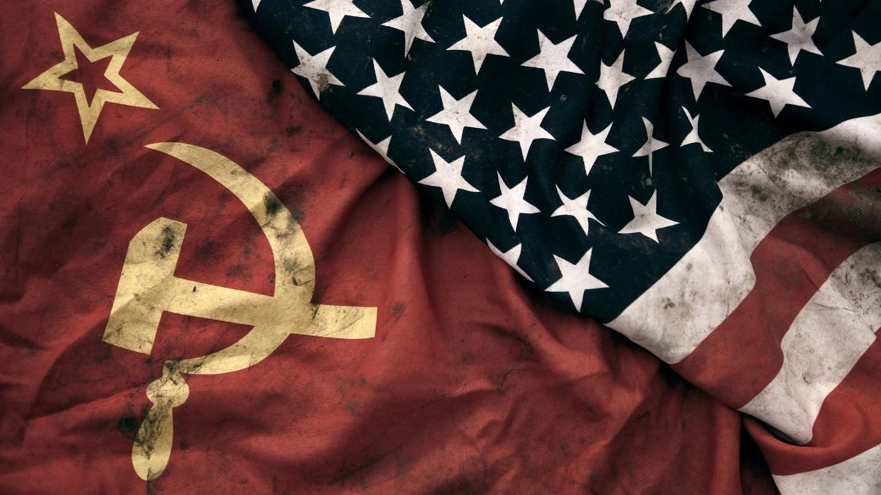
IGCSE History Revision 4. Who was to blame for the Cold War?

Slide 2
Revision Tips
Understand the different ideologies of the USA and USSR: capitalism and communism.
Remember the main sources of disagreement between the allies at Potsdam.
Link the development of Truman’s doctrine of containment to the actions of the USSR in eastern Europe.
Consider why Germany was the most sensitive issue between the superpowers after the war.
Compile a list of reasons why you think each of the superpowers, USSR and the USA, might have been to blame for the start of the Cold War.

Slide 3
Who was to Blame for the Cold War?

Slide 4
Potsdam
Spirit of cooperation had deteriorated to open disagreement (no common enemy) due to change of leadership (Truman staunch anti-communist)
Agreements to form Germany being split into 4 zones deteriorated over details of borders.
Agreement to form reparation commission deteriorated over exact amounts. Soviets wanted indefinite reparations from Soviet Zones and 10% of Industrial equipment from West-Zones. Britain and France thought this was too much.

Slide 5
Potsdam
Agreements to form Polish ‘government of national unity’ deteriorated as Stalin had non-communists arrested.
Free elections that were agreed on did not take place in Europe. Communists were coming to power which violated the percentages agreement.
Agreements to have Russia join war against Japan with US were ignored as Truman dropped atomic bomb.

Slide 6
Why did the USA-USSR alliance begin to break down in 1945?
Ideological differences: politics, lifestyle, post-war aims: USSR - communist with dictator, one party state with secret police, totalitarian, terror, propaganda, no civil liberties, USA had capitalism, multiparty elections, freedom
And civil liberties. USSR wanted weak Germany, sphere of influence and reparations, USA wanted strong Germany and no reparations.

Slide 7
Why did the USA-USSR alliance begin to break down in 1945?
Hostility in the past: white counter-revolutionary forces tried to destroy USSR in 1917 Russian Revolution and Polish invasion in 1921, USSR signed Nazi-Soviet pact + USSR signed Nazi-Soviet pact
Increasing tension due to:
Stalin refusing to join UN
Delay of D-Day and opening a second front.

Slide 8
How had USSR gained control over Eastern Europe?
Trigger: political vacuum and anarchy, want to restore law and order
Red Army had occupied Eastern Europe according to
Percentages Agreement (right) spheres of influence.
However, Stalin
Wanted to occupy more and wanted a buffer zone after loss of 20 million lives.
By July 1945, USSR controlled Baltic States, Finland, Poland, Czechoslovakia, Hungary, Bulgaria, Romania.

Slide 9
How had USSR gained control over Eastern Europe?
However, Stalin
In 1945, communists took power in Albania, Bulgaria (elected by coalition, executed opposition), & E Germany
In 1947, communists took over Romania (abolished monarchy), Poland (arrested opposition, won by election)
Hungary – arrested and executed opposition using secret police churches were attacked.
In 1948, communist leader Gottwald took power in Czechoslovakia by controlling the radio, army, police and arresting opposition. Non-communist minister Masaryk committed suicide.
1949, GDR was established

Slide 10
How did the USA respond to Soviet expansionism?
US gave aid to Greece and Turkey during their civil wars when Britain withdrew (Feb 1947) to prevent spread of Communism.
The Truman doctrine (12th March 1947) introduced containment* and marshal plan to extenuate Soviet foothold in Europe, prevent breeding ground for totalitarianism by eliminating poverty. Containment: USA accepted Eastern Europe as communist sphere but would ‘contain’ any further expansion. Prepared to send money, equipment and advice to any country under communist threat e.g. Greece and Czechoslovakia. Initially not approved by congress, when communists won the civil war in Czechoslovakia (1948), Marshall Aid worth $17 billion was released. (March 1948).

Slide 11
How did the USA respond to Soviet expansionism?
Marshall Aid offered to all countries including USSR & discussed during Paris Conference (July 1947) but Stalin forbade communists to go. Started Cominform (Oct 1947) and COMECON to support iron curtain economies.
Iron curtain speech led to an atmosphere of tension, recrimination and mutual demonization.

Slide 12
How did the USA respond to Soviet expansionism?
What were the aims of the Marshall Plan
To aid rebuilding of Europe
To restore economy and curb communism’s appeal and spread capitalism
Form allies close to USSR & extenuate their foothold
Expand markets to prevent worldwide slump
Dominate Europe by making them dependent on $

Slide 13
How did the USA respond to Soviet expansionism?
Cominform aims:
Spread revolution and provide assistance to Soviet satellites & communist parties
Defend satellites against US influence
Keep a close eye on satellites
Ensure loyalty
All Eastern European countries must be communist

Slide 14
What were the consequences of the Berlin Blockade?
Background: As Marshall Aid (response to Czech communists – paranoia) was started in March 1948, Stalin began partial blockage on roadways to Berlin. Aim: to stamp his authority on Berlin as he was helpless about everything else, force allies out of Berlin, making West Berlin dependent on USSR, he wanted to destroy Germany & saw Marshall Aid as dollar imperialism which was a threat to USSR, also to stop Germany recovering to prevent threat to USSR.
On 1st June 1948, West Germany was a new country – FDR and on 23rd June had a new currency = which led to economic crisis for USSR.

Slide 15
What were the consequences of the Berlin Blockade?
Consequences: Germany permanently divided. Iron curtain concept strengthened. An open confrontation of the cold war, tensions got much worse. NATO formed in 1949 and Warsaw Pact in 1955 - two armed camps. Arms race also began set up a ‘tense balance’ with no hot war which was symbolic of the cold war period. Tensions increased as allies merged zones (1946 – Trizonia), new currency/new countries/iron curtain speech, Berlin blockade, Marshall Aid. (1945- 1949)

Slide 16
What were the consequences of the Berlin Blockade?
Destalinization: Policy started by Khrushchev during the era of peaceful coexistence. Tito (Yugoslavia) was allowed autonomy to ease relations, who then left Warsaw Pact. Closed down Cominform as a part of his policy of reconciliation with Tito. Khrushchev thought Stalin was inhumane so he invited Tito to Moscow and dismissed Molotov, executed Beria (head of state secret police), set free political prisoners, pulled out of Austria, met western leaders at post war summits (July ’55) and criticized Stalin’s Purges, terror, tyranny on 20th party congress, eased relation with China, reduced arms expenditure, improved living standards. Main aim did not change: must create buffer against attack from West through Warsaw Pact.

Slide 17
Who was more to blame for the cold war?
Blame USSR for radical ideology dedicated to world revolution and justifies perception of threat
Blame USA for underestimating USSR’s loss and misperceiving defense as hostility
Blame both for miscommunication, tension, and ideological differences.

